Slide 1
Perot Museum of Nature and Science
Final Lighting Design Presentation
Yucheng Lu, Lighting|Electrical, Adviser: Shawn Good

Slide 2
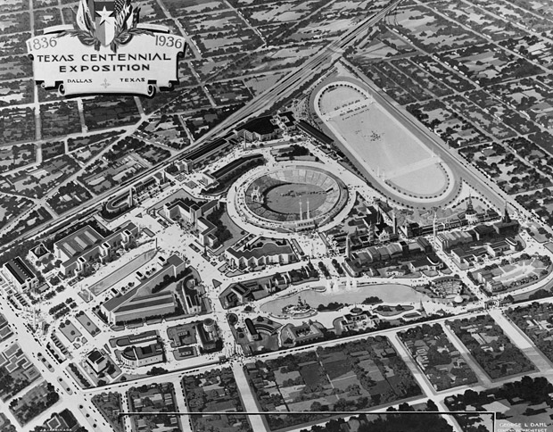
Dallas Museum of Natural History
Established in 1936, Dallas Museum of Natural History is a collections-based, research-driven public natural history museum dedicated to document and describe Texas' vast natural diversity.
Introduction
Classroom
Theater
Façade
Summary
Project History
Building Overview
Design Concept
Lighting | Electrical | Daylighting | Acoustical | Architectural P1

Slide 3

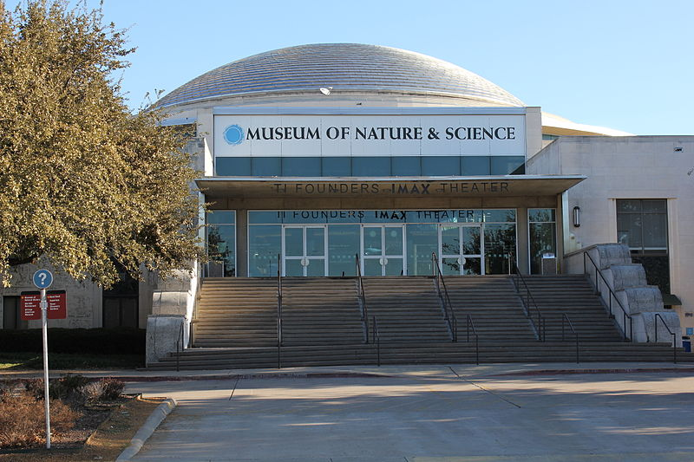
Dallas Museum of Natural History
Established in 1936, Dallas Museum of Natural History is a collections-based, research-driven public natural history museum dedicated to document and describe Texas' vast natural diversity.
Dallas Museum of Nature and Science
In 2006, the Dallas Museum of Natural History merged with two other institutes: Science Place and The Dallas Children's Museum, became the Dallas Museum of Nature and Science.
Introduction
Classroom
Theater
Façade
Summary
Project History
Building Overview
Design Concept
Lighting | Electrical | Daylighting | Acoustical | Architectural P1

Slide 4

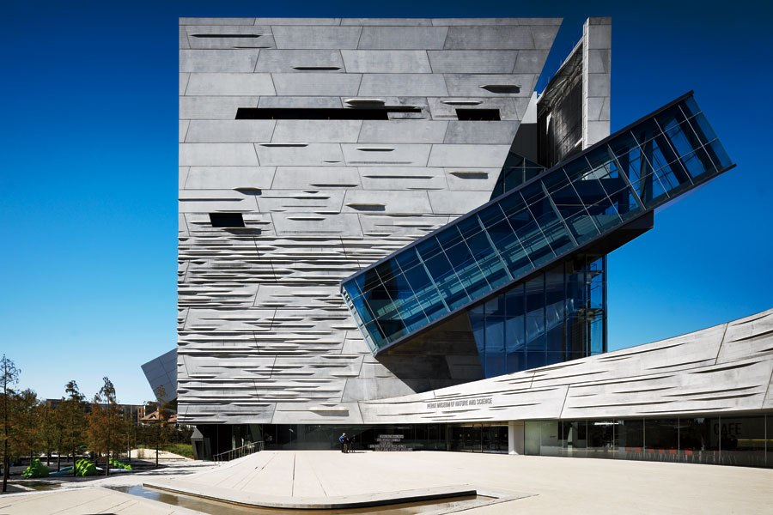
Dallas Museum of Natural History
Established in 1936, Dallas Museum of Natural History is a collections-based, research-driven public natural history museum dedicated to document and describe Texas' vast natural diversity.
Dallas Museum of Nature and Science
In 2006, the Dallas Museum of Natural History merged with two other institutes: Science Place and The Dallas Children's Museum, became the Dallas Museum of Nature and Science.
Perot Museum of Nature and Science
The merge turns out to be successful and allowed the museum to relocate into its new victory park campus in 2012.
Introduction
Classroom
Theater
Façade
Summary
Project History
Building Overview
Design Concept
Lighting | Electrical | Daylighting | Acoustical | Architectural P1

Slide 5
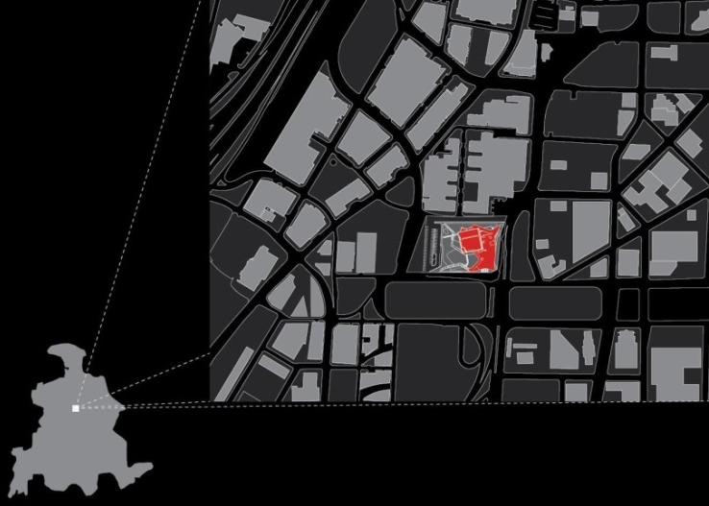
Introduction
Classroom
Theater
Façade
Summary
Project History
Building Overview
Design Concept
Lighting | Electrical | Daylighting | Acoustical | Architectural P2

Slide 6
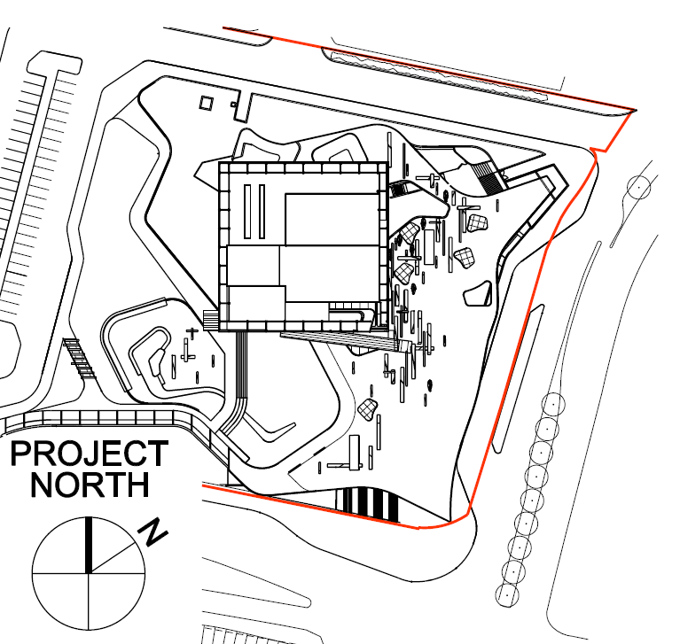
Building name: Perot Museum of Nature and Science
Location and site: 2201 N Field St, Dallas, TX 75201
Occupancy : Public Museum
Size: 180,000 ft^2
Total Levels: 5
Dates of construction: 05/2010 – 12/2012
Introduction
Classroom
Theater
Façade
Summary
Project History
Building Overview
Design Concept
Lighting | Electrical | Daylighting | Acoustical | Architectural P2

Slide 7
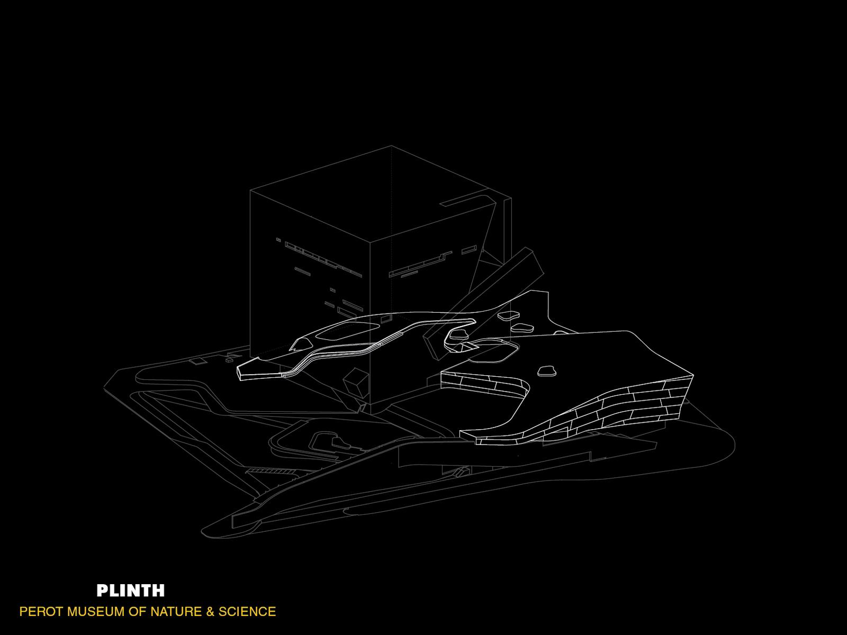
Artificial landscape plinth is built around the museum, serving as the roof of basement and theater.
Introduction
Classroom
Theater
Façade
Summary
Project History
Building Overview
Design Concept
Lighting | Electrical | Daylighting | Acoustical | Architectural P3

Slide 8
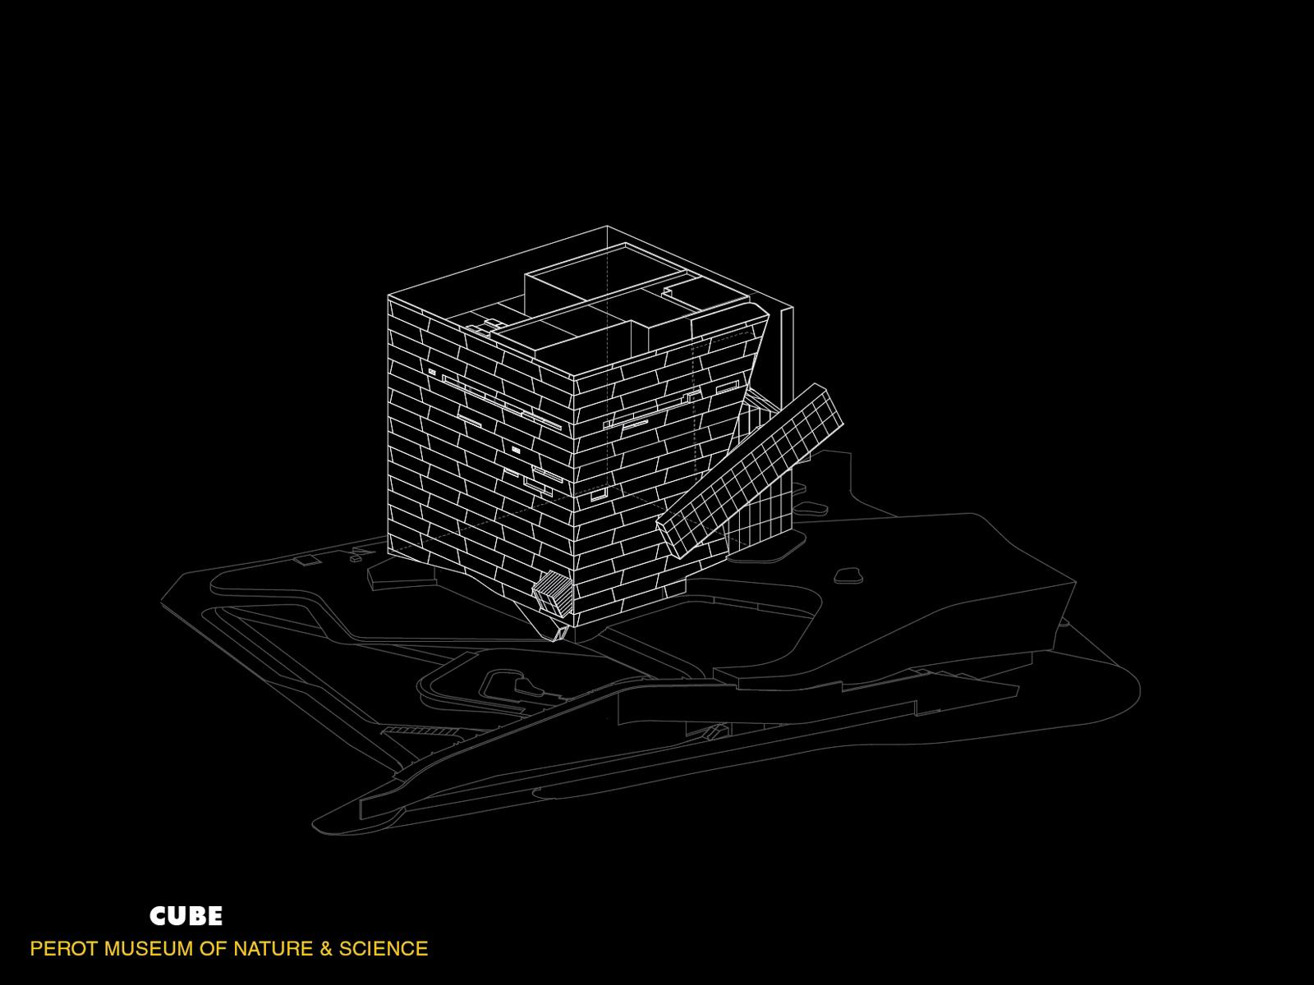
Artificial landscape plinth is built around the museum, serving as the roof of basement and theater.
Precast concrete panel is assembled into a iconic textured facade. A 150 feet long escalator cartridge is attached on the facade to provide a unique riding experience.
Introduction
Classroom
Theater
Façade
Summary
Project History
Building Overview
Design Concept
Lighting | Electrical | Daylighting | Acoustical | Architectural P4

Slide 9
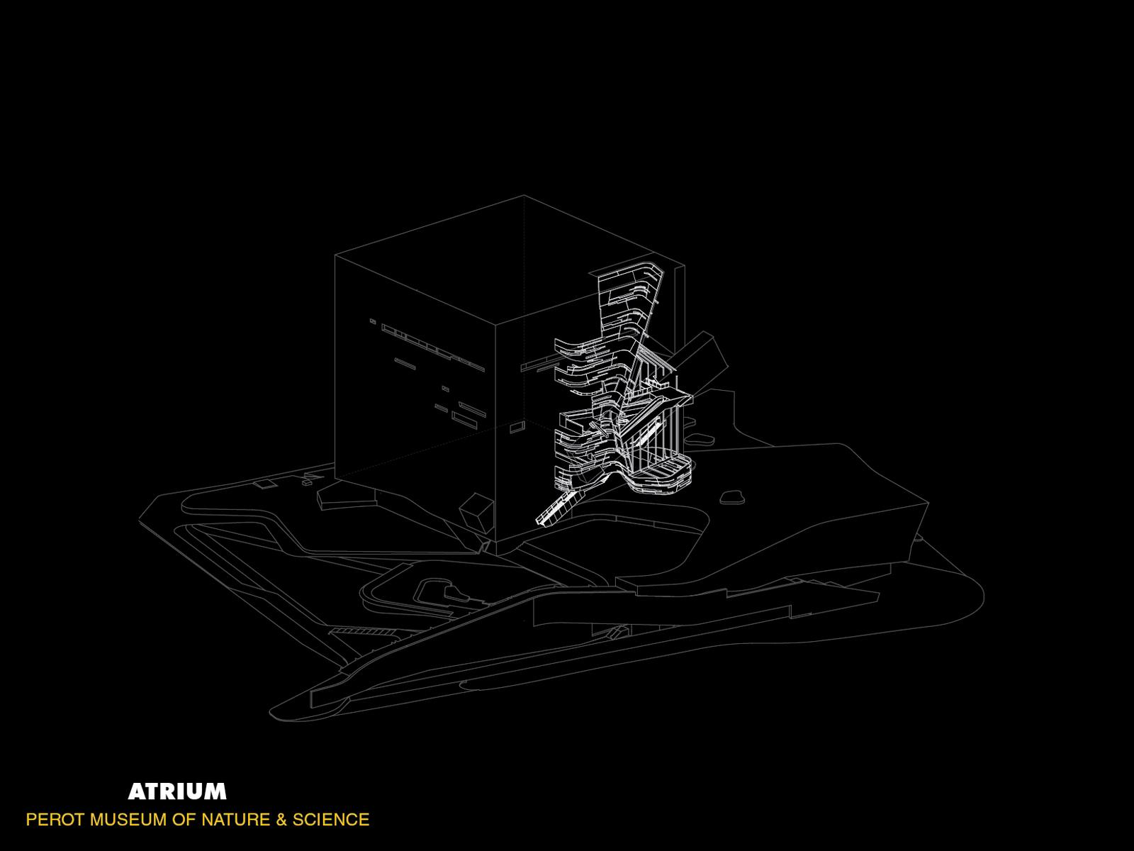
Artificial landscape plinth is built around the museum, serving as the roof of basement and theater.
Precast concrete panel is assembled into a iconic textured facade. A 150 feet long escalator cartridge is attached on the facade to provide a unique riding experience.
Atrium on the south east corner of the building replaced precast concrete with glazings, brings daylight into the space as well as a excellent view.
Introduction
Classroom
Theater
Façade
Summary
Project History
Building Overview
Design Concept
Lighting | Electrical | Daylighting | Acoustical | Architectural P5

Slide 10
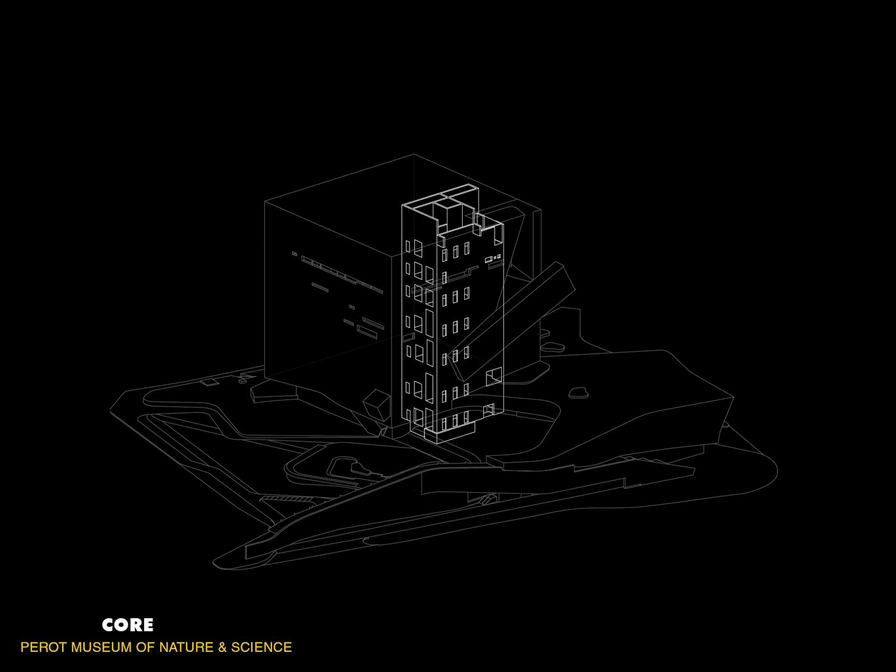
Artificial landscape plinth is built around the museum, serving as the roof of basement and theater.
Precast concrete panel is assembled into a iconic textured facade. A 150 feet long escalator cartridge is attached on the facade to provide a unique riding experience.
Atrium on the south east corner of the building replaced precast concrete with glazings, brings daylight into the space as well as a excellent view.
Core structure of the building formed an isolated space from the open exhibition hall to host electrical and mechanical devices as well as elevator well.
Introduction
Classroom
Theater
Façade
Summary
Project History
Building Overview
Design Concept
Lighting | Electrical | Daylighting | Acoustical | Architectural P6

Slide 11
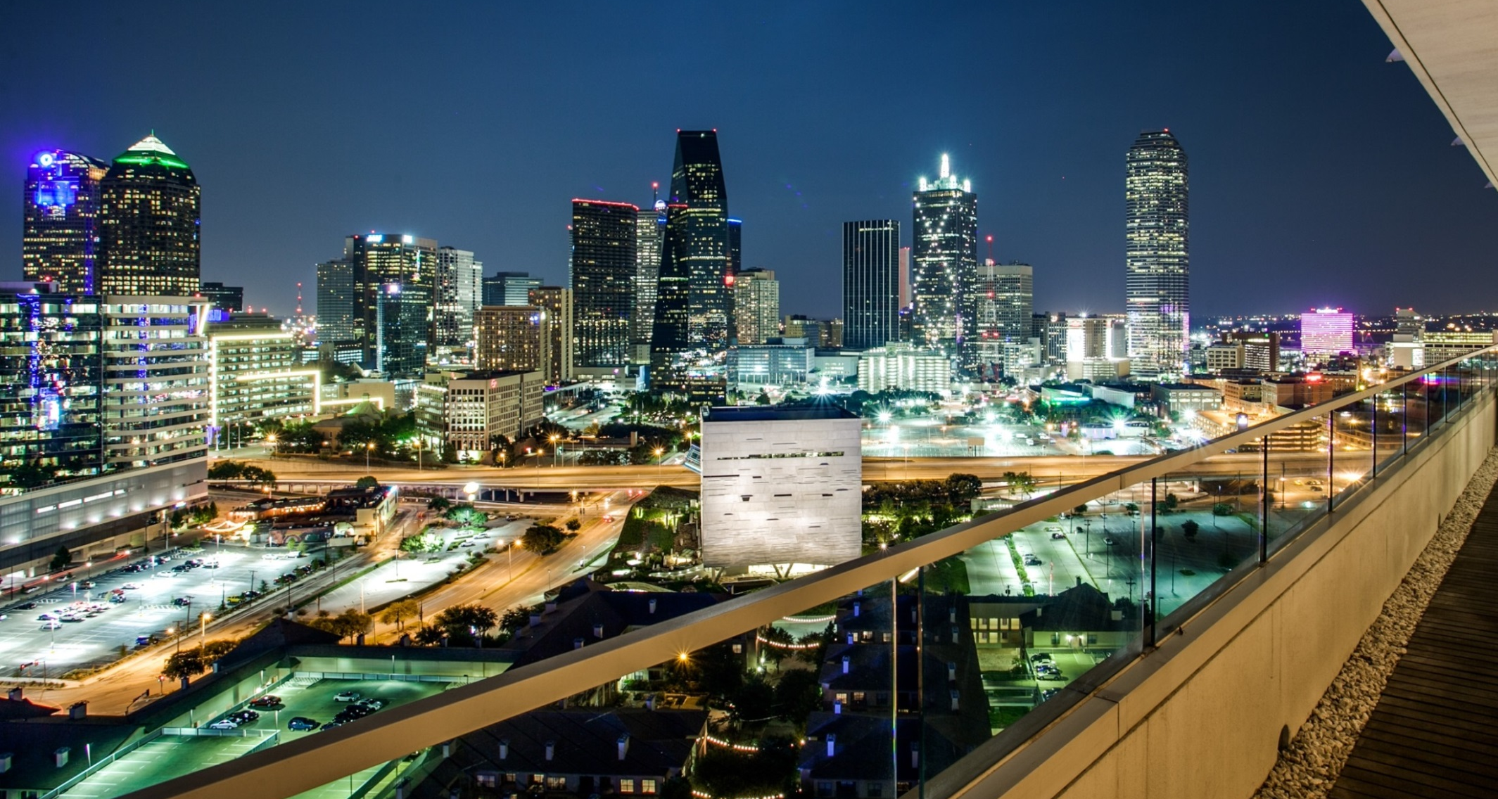
“I envision Victory Park as an urban lifestyle destination”
- Ross Perot, Donor & Developer
Introduction
Classroom
Theater
Façade
Summary
Project History
Building Overview
Design Concept
Lighting | Electrical | Daylighting | Acoustical | Architectural P7

Slide 12
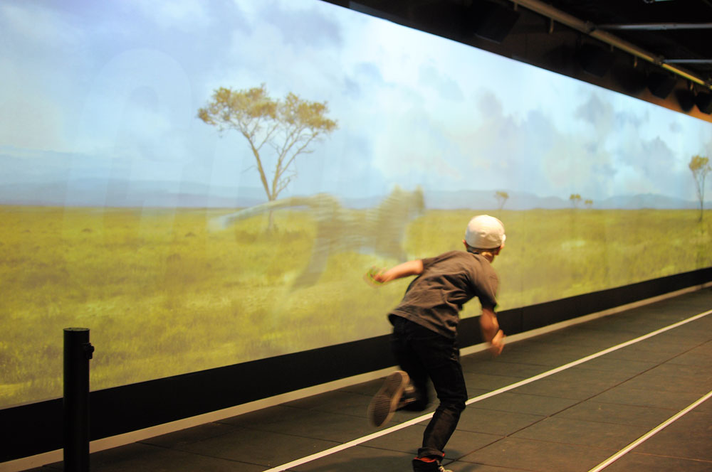
“I envision Victory Park as an urban lifestyle destination”
- Ross Perot, Donor & Developer
“Once museums were combined, the ambition was to replace them with a new building that would seamlessly unite these variegated strands”
“We are Excited to bring some amazing family attractions”
- Nicole Small, Museum CEO
Introduction
Classroom
Theater
Façade
Summary
Project History
Building Overview
Design Concept
Lighting | Electrical | Daylighting | Acoustical | Architectural P8

Slide 13
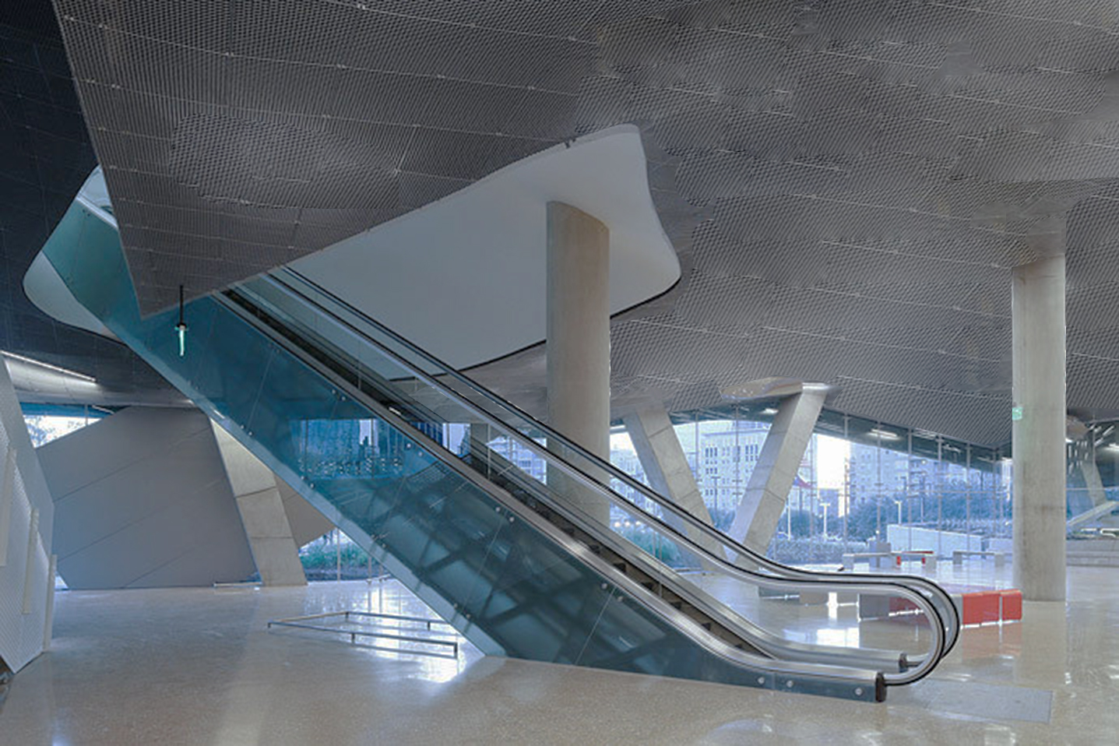
“I envision Victory Park as an urban lifestyle destination”
- Ross Perot, Donor & Developer
“Once museums were combined, the ambition was to replace them with a new building that would seamlessly unite these variegated strands”
“We are Excited to bring some amazing family attractions”
- Nicole Small, Museum CEO
“The experience is about a sequence of moving, a journey. The whole building is about being didactic and itself is an exhibit.”
“The building is compelling and will expand user’s imagination. Everywhere in the building will be left transparent and you will understand architecture”
- Thom Mayne, Morphosis Architect
Introduction
Classroom
Theater
Façade
Summary
Project History
Building Overview
Design Concept
Lighting | Electrical | Daylighting | Acoustical | Architectural P9

Slide 14

Educate
Design lighting solutions that help demonstrate unique architectural features and inspire visitors.
Peace
Create a relaxing atmosphere, allow the museum to function as a retreat from fast paced urban life.
Entertain
Treat lighting system as part of the exhibition, adding visual interest into the museum.
Introduction
Classroom
Theater
Façade
Summary
Urban
Project History
Building Overview
Design Concept
Peace
Entertain
Unite
Nature
Science
Educate
Lighting | Electrical | Daylighting | Acoustical | Architectural P10

Slide 15
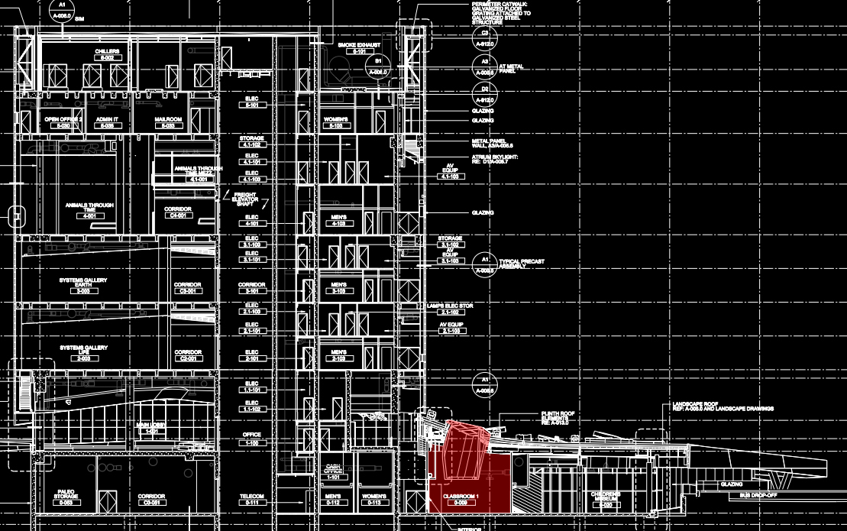
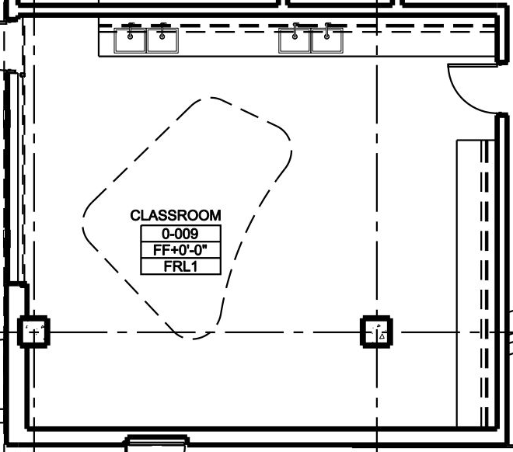
Classroom
Dimensions:
Length = 31 ft
Width = 25 ft
Area = 735 ft^2
Ceiling Height = 12 ft
Roof Height = 28 ft in average
Light Well Height = 16 ft
Introduction
Classroom
Theater
Façade
Summary
Design Criteria
Design Approach
Design Result
Lighting | Electrical | Daylighting | Acoustical | Architectural P11

Slide 16
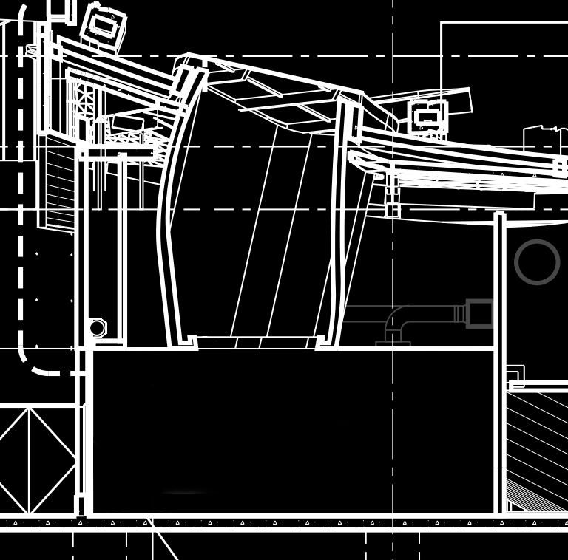
Design Criteria
Create an atmosphere remarkably distinct from typical education facilities to offer an exciting learning experience.
Incorporate light well system into the design to create a three dimensional lighting scheme that demonstrates Architectural feature.
Target Power Density: 1.28 W/SF
Introduction
Classroom
Theater
Façade
Summary
Design Criteria
Design Approach
Design Result
Lighting | Electrical | Daylighting | Acoustical | Architectural P12

Slide 17
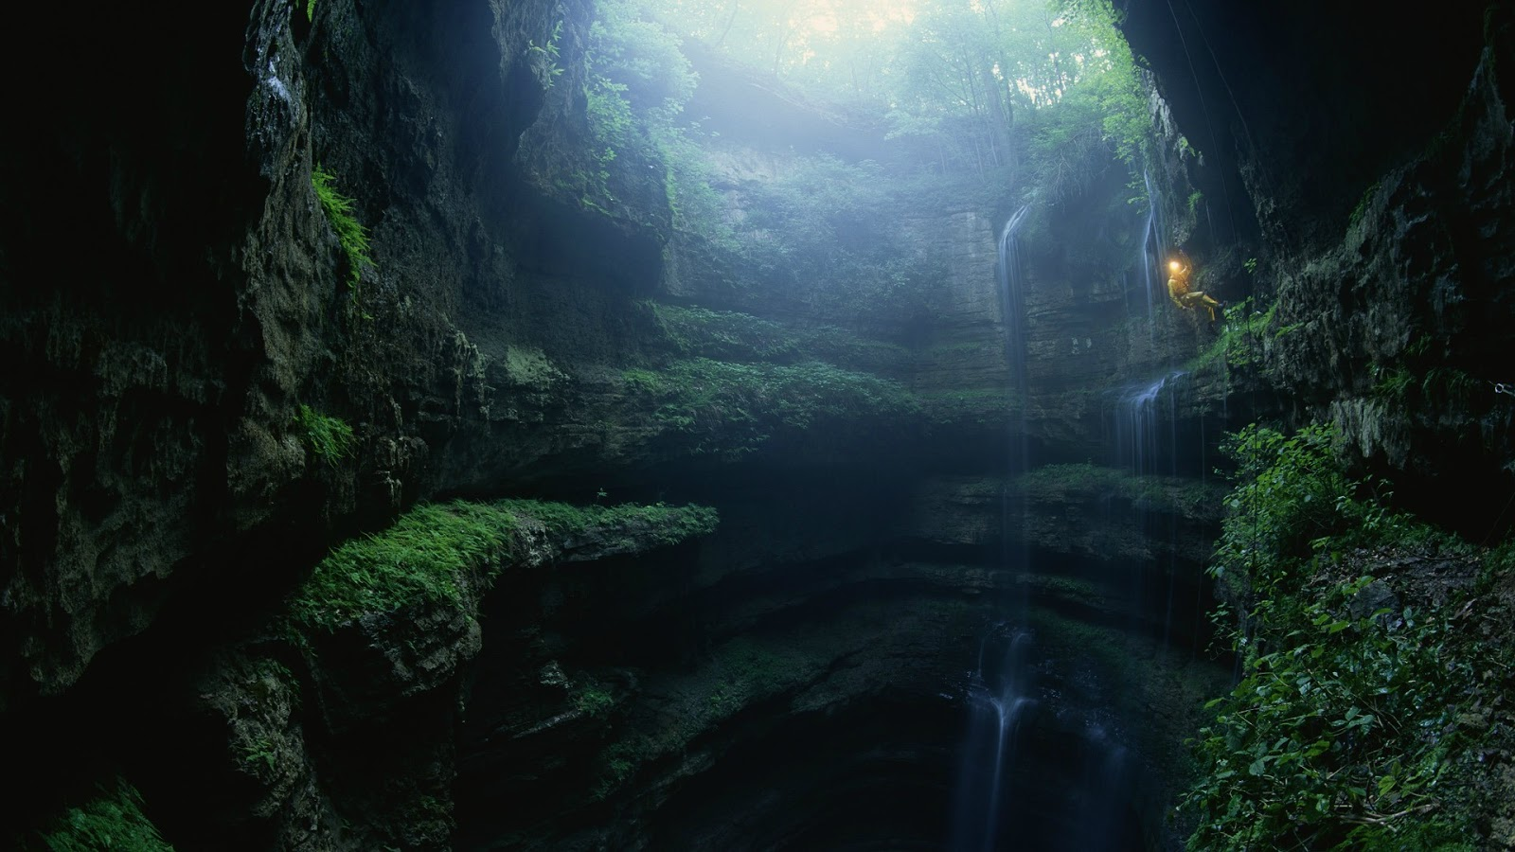
Design Approach
Lighting design focus on simulating an underground cave theme, using the light well as the only natural light.
Introduction
Classroom
Theater
Façade
Summary
Design Criteria
Design Approach
Design Result
Lighting | Electrical | Daylighting | Acoustical | Architectural P13

Slide 18
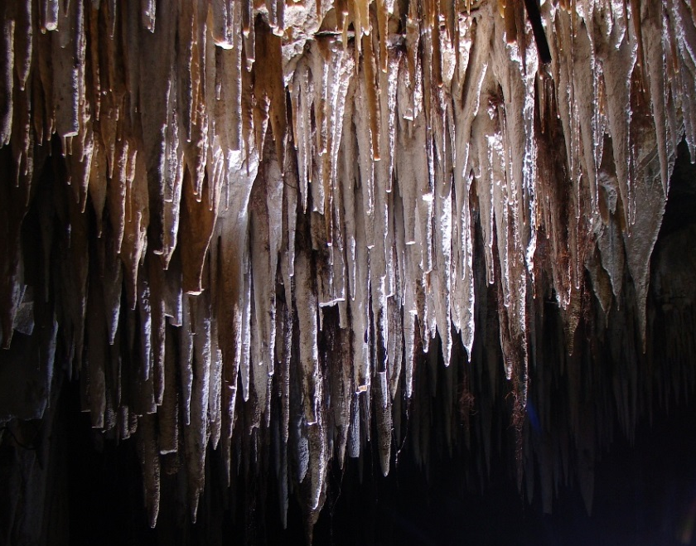
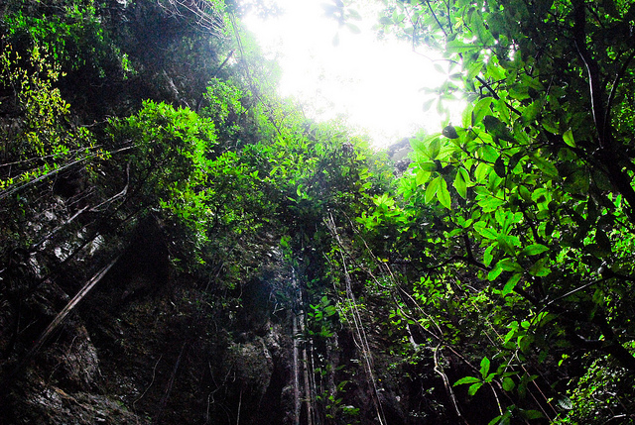
Design Approach
Lighting design focus on simulating an underground cave theme, using the light well as the only natural light.
Typical cave elements such as stalactites and Cave plants are simulated though luminaire and finishing to enhance the theme.
Introduction
Classroom
Theater
Façade
Summary
Design Criteria
Design Approach
Design Result
Lighting | Electrical | Daylighting | Acoustical | Architectural P13

Slide 19
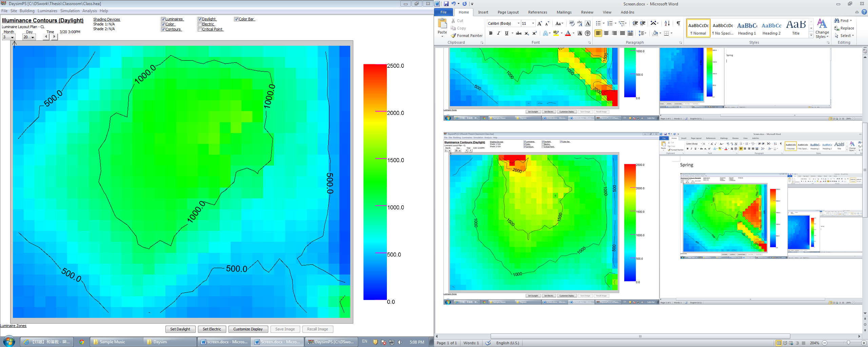
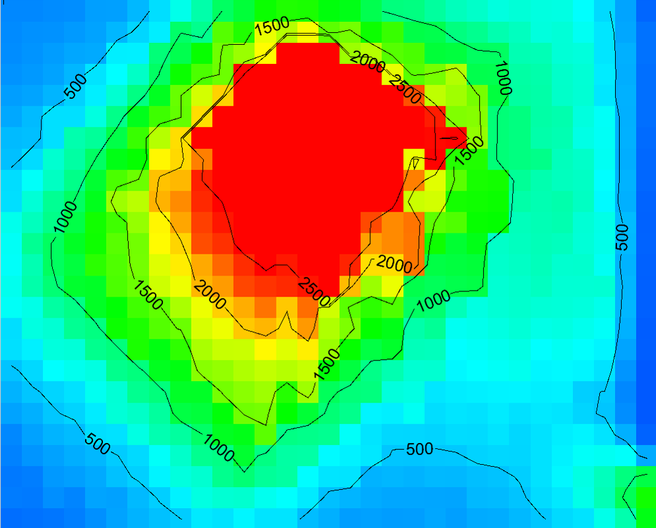
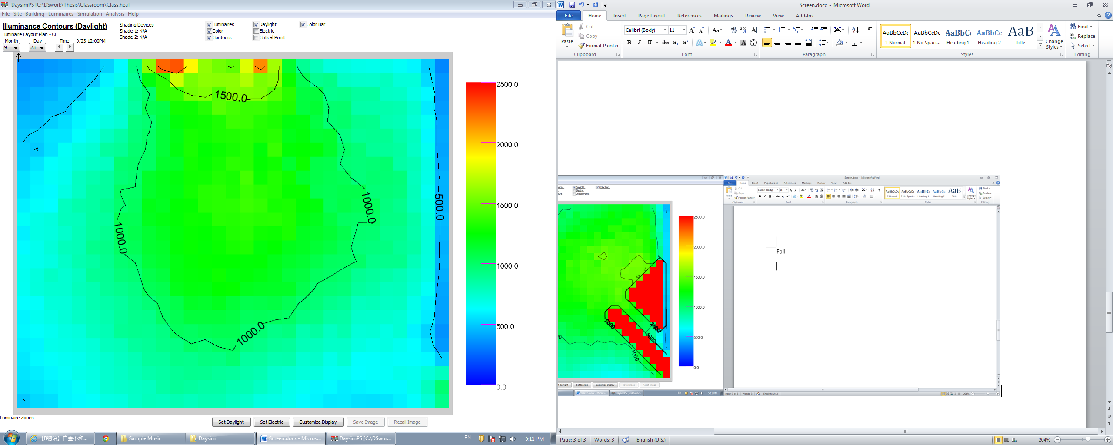
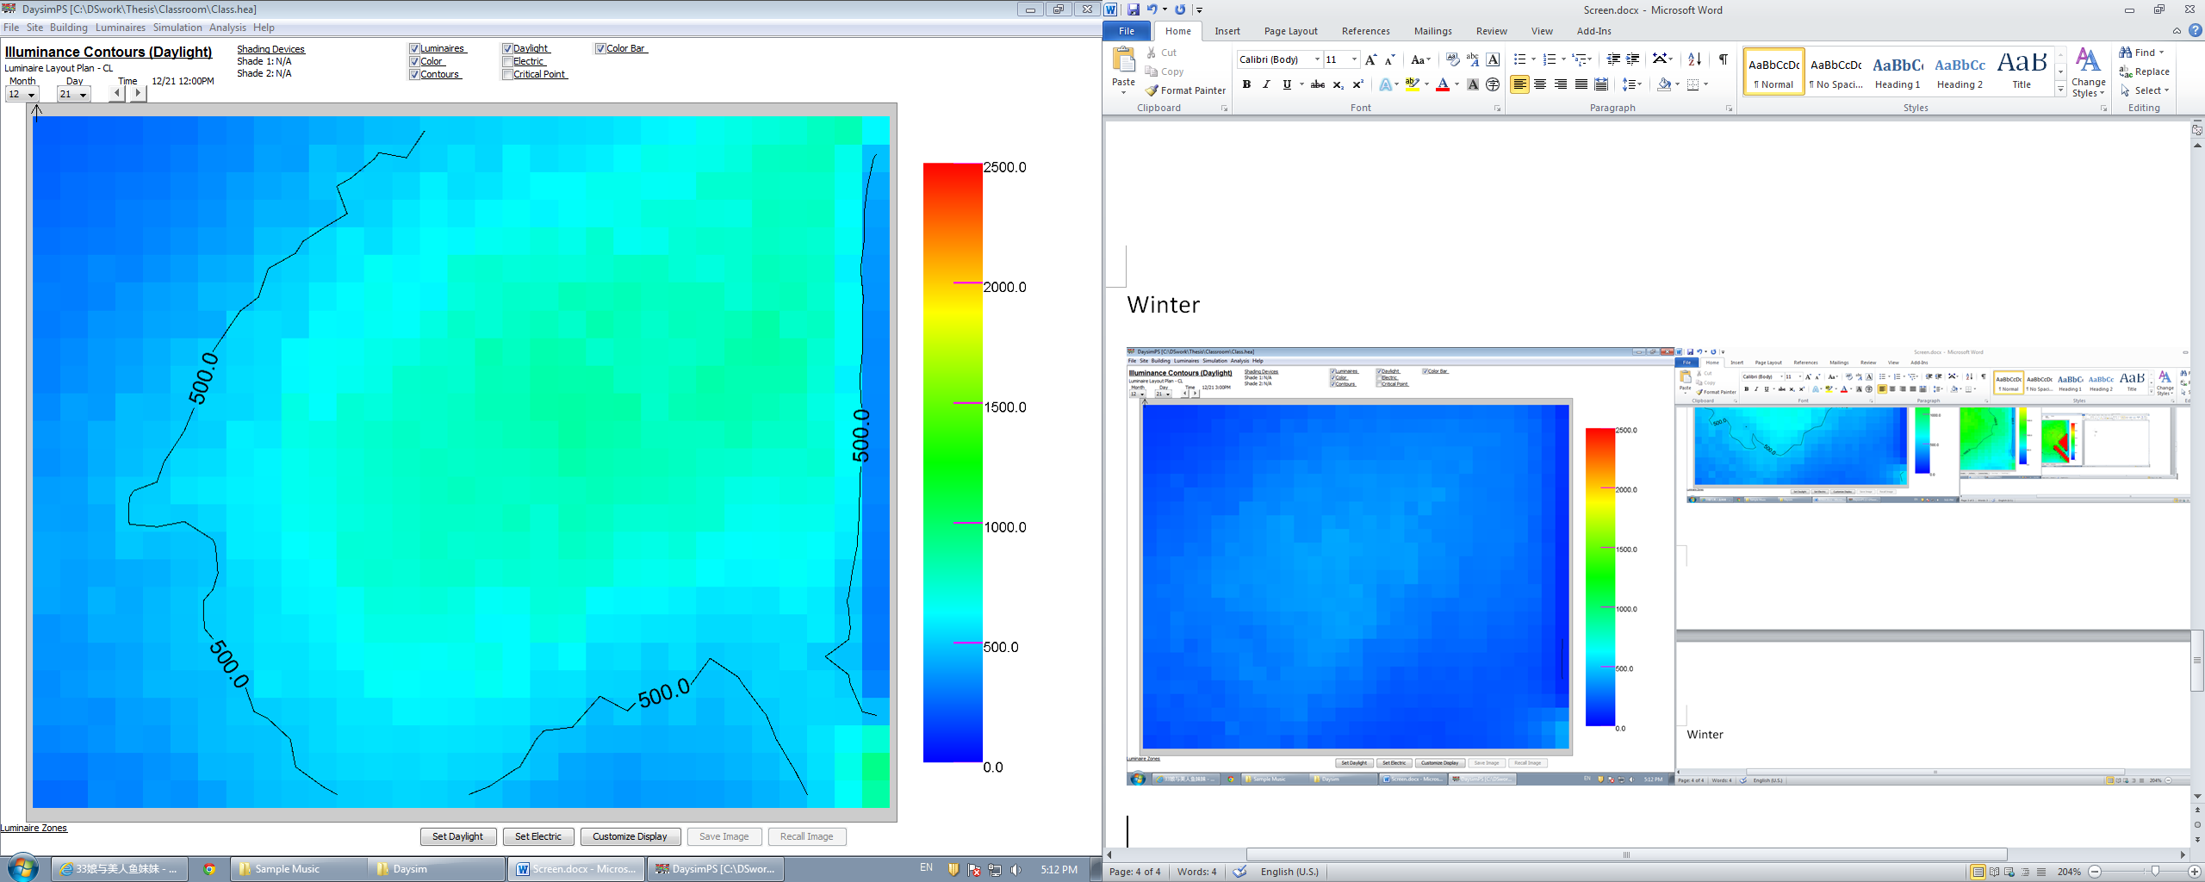
Design Approach
Lighting design focus on simulating an underground cave theme, using the light well as the only natural light.
Typical cave elements such as stalactites and Cave plants are simulated though luminaire and finishing to enhance the theme.
Program based daylighting simulation is also used to assist with lighting layout and control strategy design.
Introduction
Classroom
Theater
Façade
Summary
Design Criteria
Design Approach
Design Result
Spring Equinox, 12 PM Summer Solstice, 12 PM
Fall Equinox, 12 PM Winter Solstice, 12 PM
Lighting | Electrical | Daylighting | Acoustical | Architectural P14

Slide 20
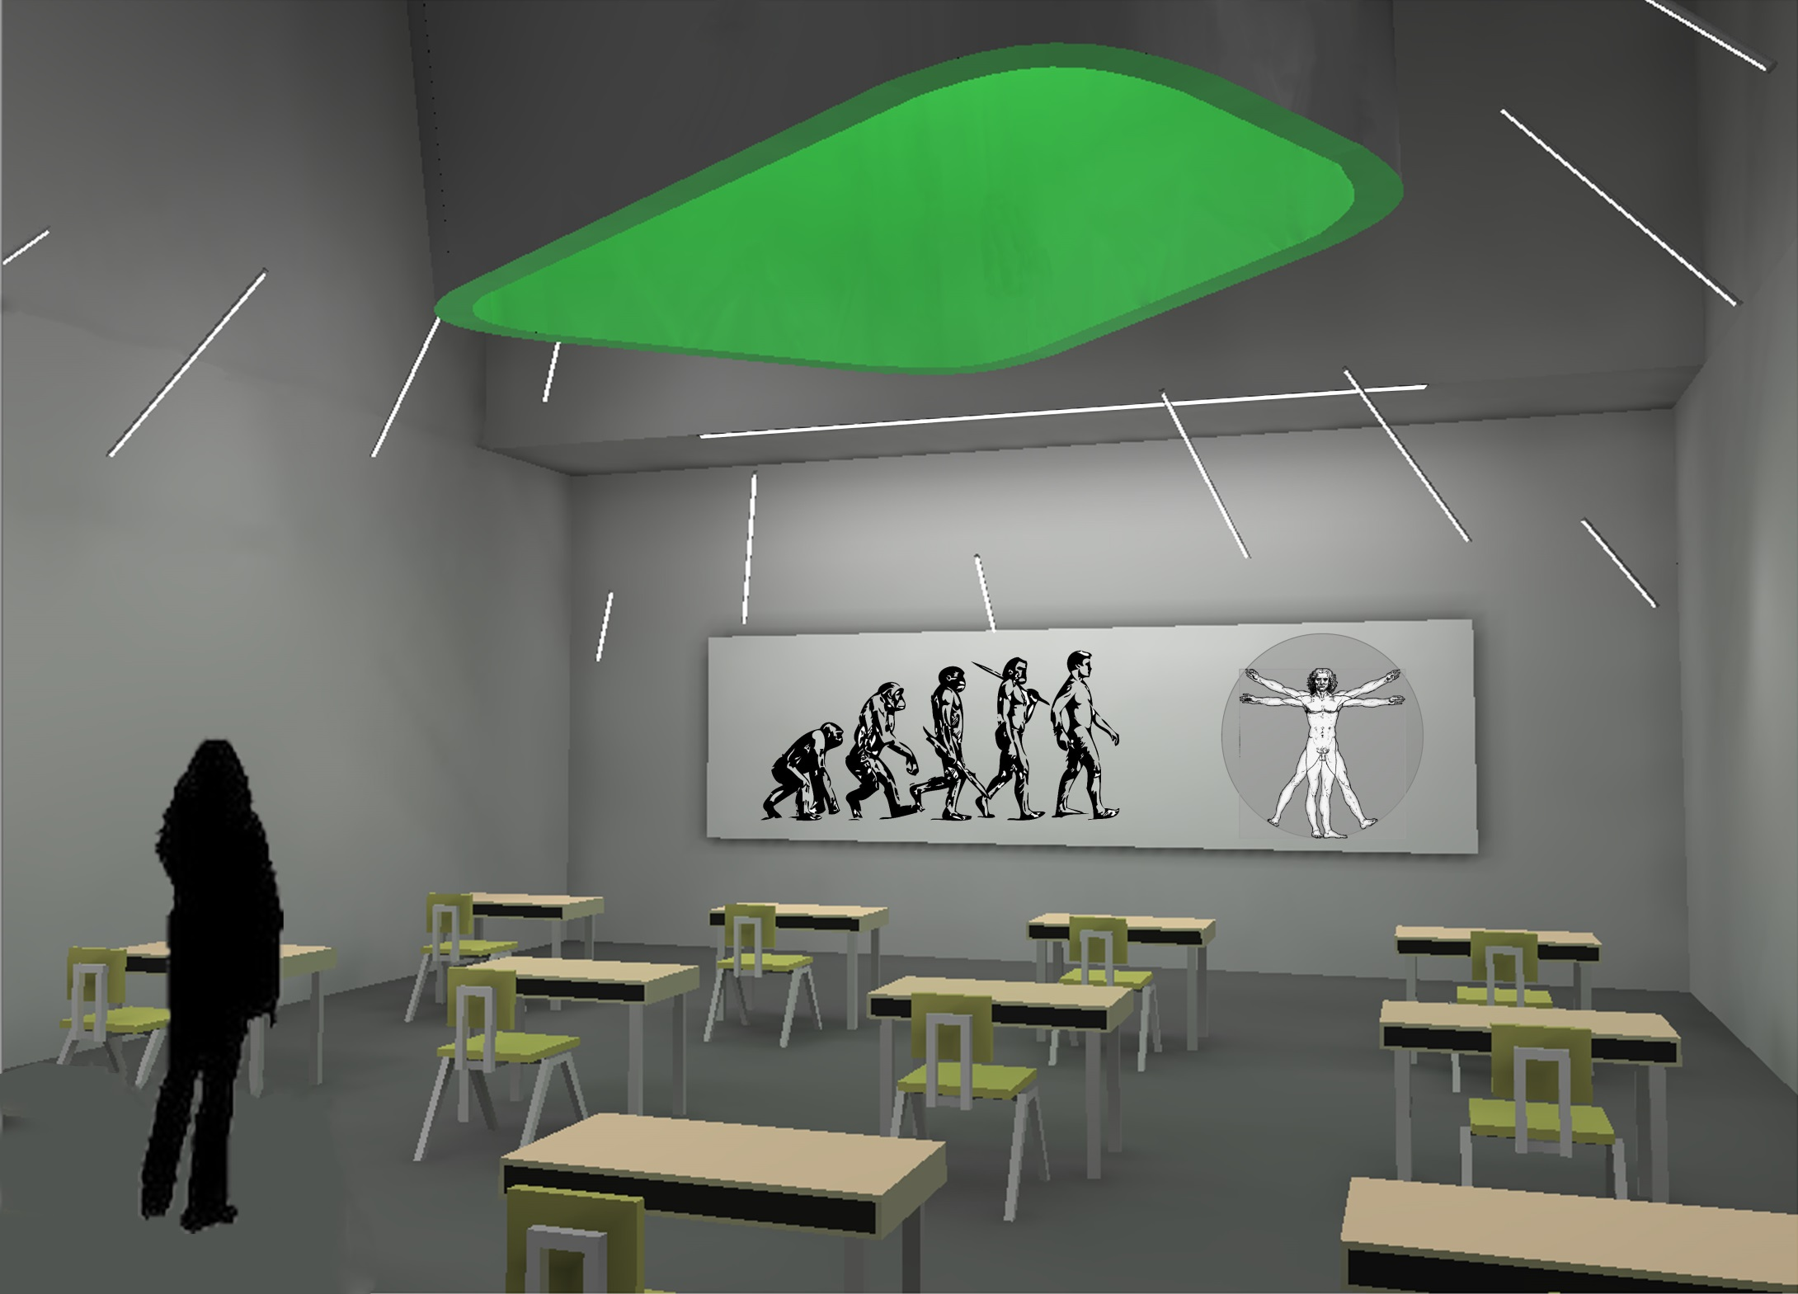
Design Result
LED tubes are arranged in a way to surround the light well, gathering attention on it.
Wide distribution floodlight inside the light well made the entire structure itself a luminaire, distributing light throughout the space uniformly.
Whiteboard is illuminated by wall washer to guarantees sufficient light level.
Actual Power Density: 1.05 W/SF
Introduction
Classroom
Theater
Façade
Summary
Design Criteria
Design Approach
Design Result
Lighting | Electrical | Daylighting | Acoustical | Architectural P15

Slide 21
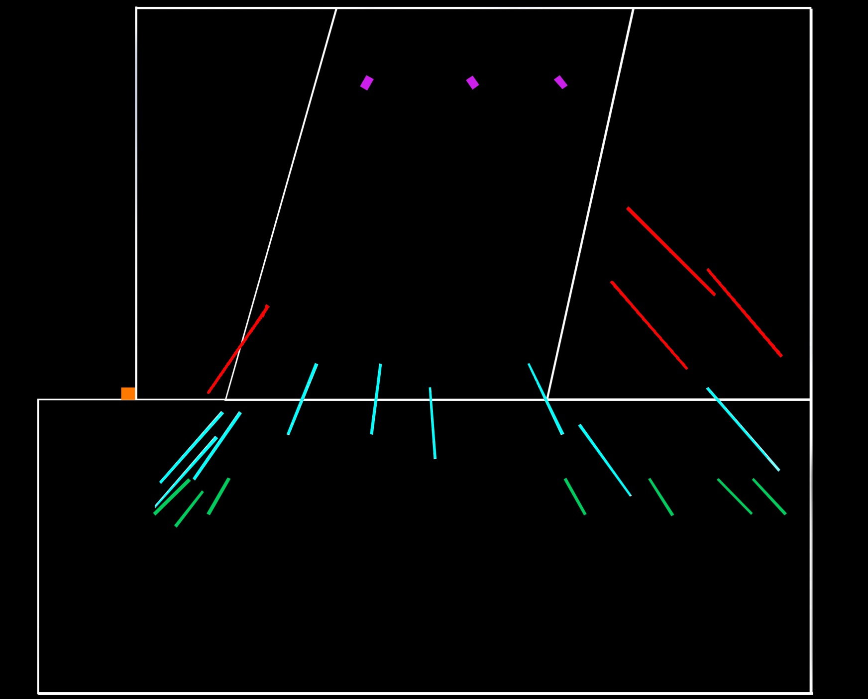
Introduction
Classroom
Theater
Façade
Summary
Design Criteria
Design Approach
Design Result
Lighting | Electrical | Daylighting | Acoustical | Architectural P16

Slide 22
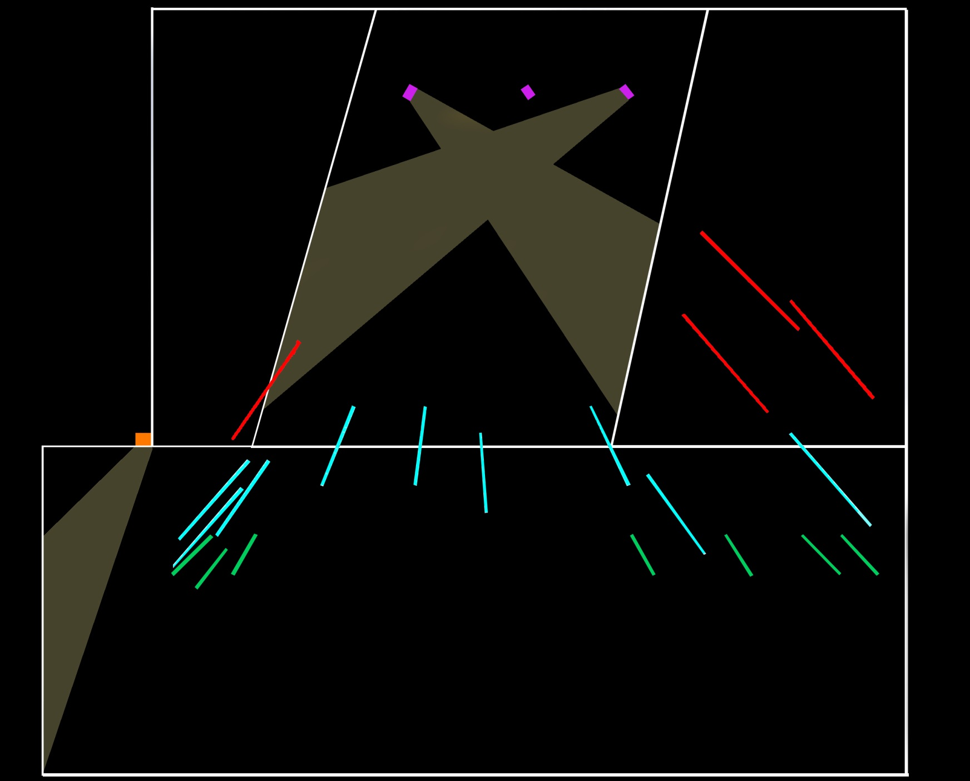
Introduction
Classroom
Theater
Façade
Summary
Design Criteria
Design Approach
Design Result
Lighting | Electrical | Daylighting | Acoustical | Architectural P16

Slide 23
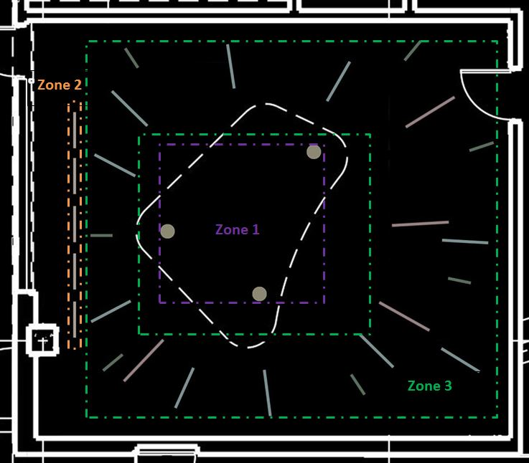
Introduction
Classroom
Theater
Façade
Summary
Design Criteria
Design Approach
Design Result
Lighting | Electrical | Daylighting | Acoustical | Architectural P16

Slide 24
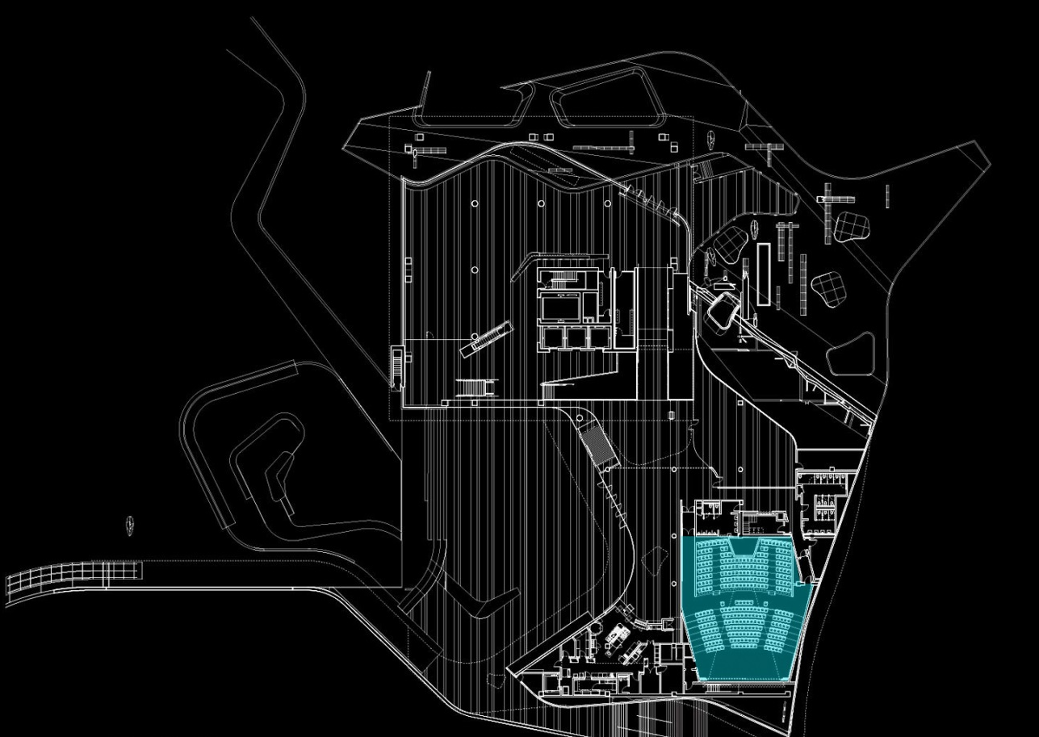
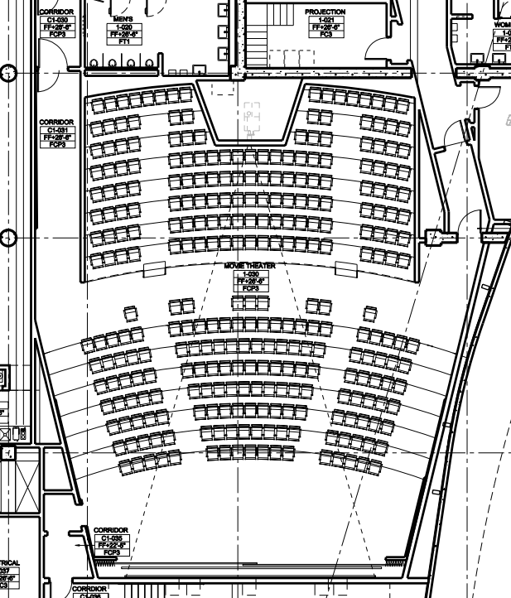
Theater
Dimensions
Approximate Area = 3726 ft^2
Length = 69 ft
Width at Front Row = 43 ft
Width at Back Row = 64 ft
Ceiling Height at Front Row = 22 ft
Ceiling Height at Back Row = 18 ft
Introduction
Classroom
Theater
Façade
Summary
Design Criteria
Design Approach
Design Result
Lighting | Electrical | Daylighting | Acoustical | Architectural P17

Slide 25
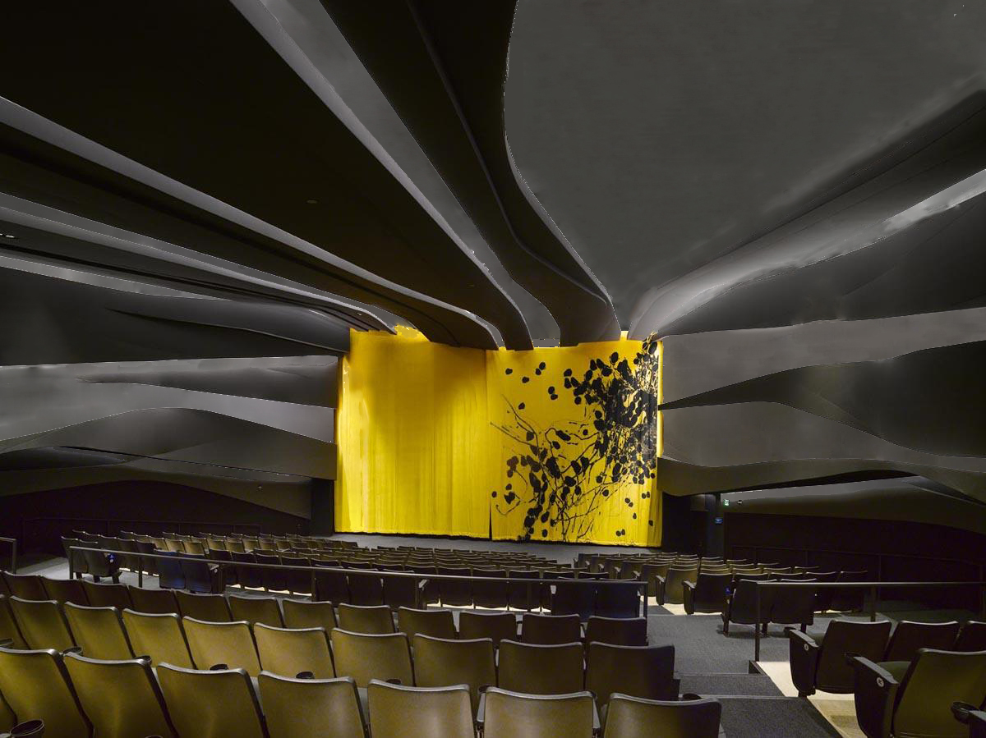
Design Criteria
Lighting design should be integrated with acoustic feature and reinforces its visual impact.
Lighting solution should dominate the space with a inspiring theme, allow audience to see things from an unusual perspective.
Target Power Density: 0.52 W/SF
Introduction
Classroom
Theater
Façade
Summary
Design Criteria
Design Approach
Design Result
Lighting | Electrical | Daylighting | Acoustical | Architectural P18

Slide 26

Design Approach
Lighting features are used to mimic a integrated circuit, demonstrating the working philosophy of electronic devices.
Introduction
Classroom
Theater
Façade
Summary
Design Criteria
Design Approach
Design Result
Lighting | Electrical | Daylighting | Acoustical | Architectural P19

Slide 27
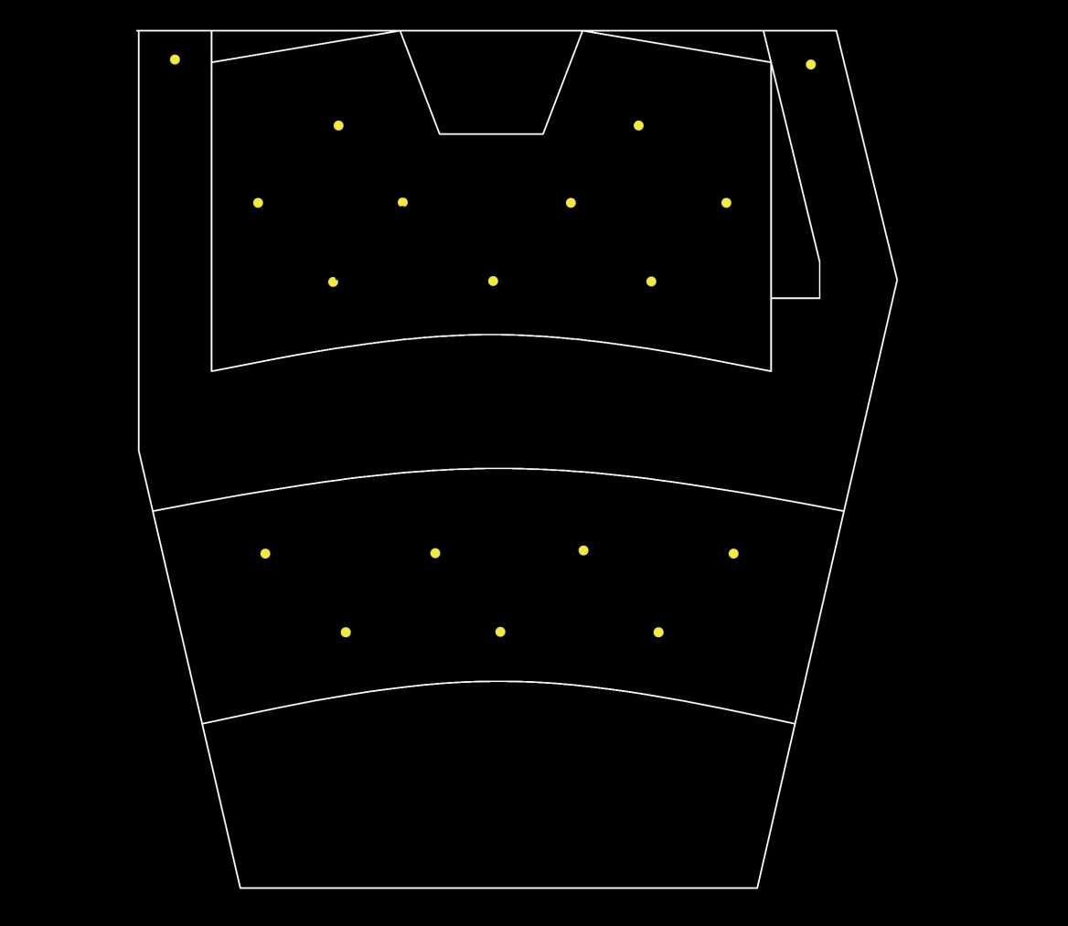
Design Approach
Lighting features are used to mimic a integrated circuit, demonstrating the working philosophy of electronic devices.
Introduction
Classroom
Theater
Façade
Summary
Design Criteria
Design Approach
Design Result
Lighting | Electrical | Daylighting | Acoustical | Architectural P19

Slide 28
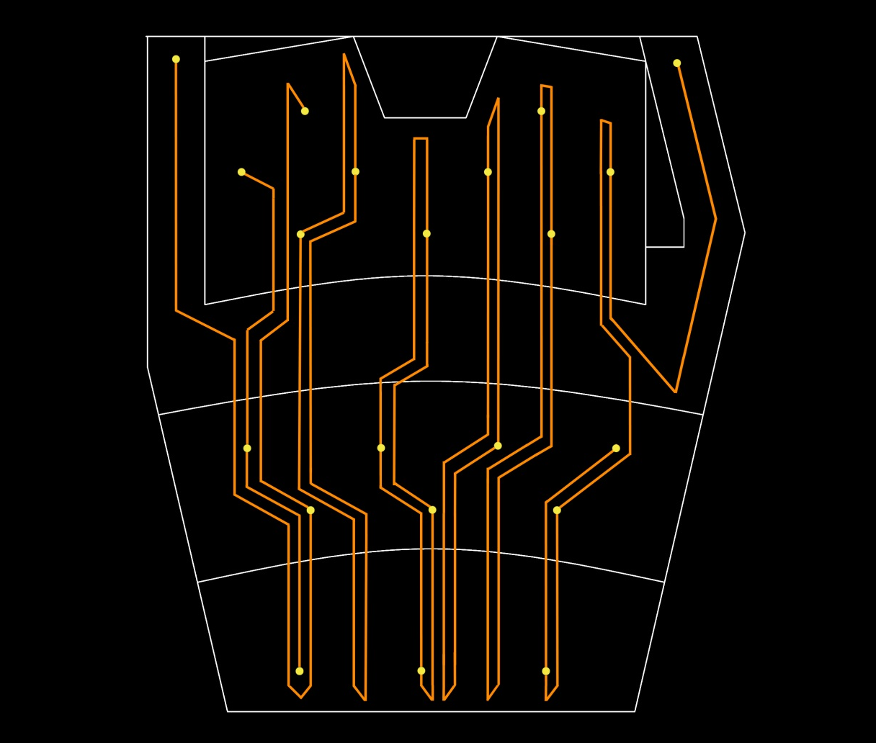
Design Approach
Lighting features are used to mimic a integrated circuit, demonstrating the working philosophy of electronic devices.
Introduction
Classroom
Theater
Façade
Summary
Design Criteria
Design Approach
Design Result
Lighting | Electrical | Daylighting | Acoustical | Architectural P19

Slide 29
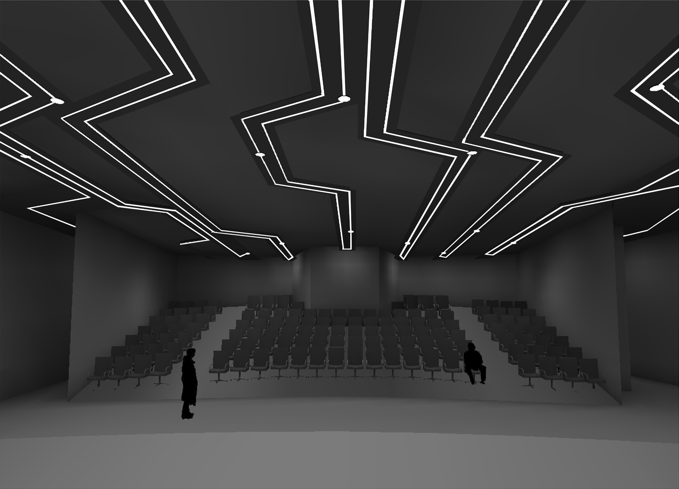
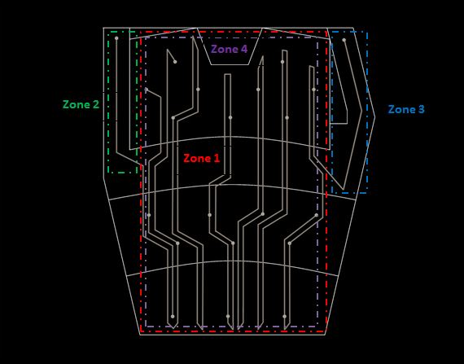
Design Result
Linear LED distributed in a seemingly random pattern to provide visual impact. Uniformly distributed downlights regulates the flow of ‘circuit’ from being too random and create hot spot.
Actual Power Density: 0.52 W/SF
Introduction
Classroom
Theater
Façade
Summary
Design Criteria
Design Approach
Design Result
Lighting | Electrical | Daylighting | Acoustical | Architectural P20

Slide 30
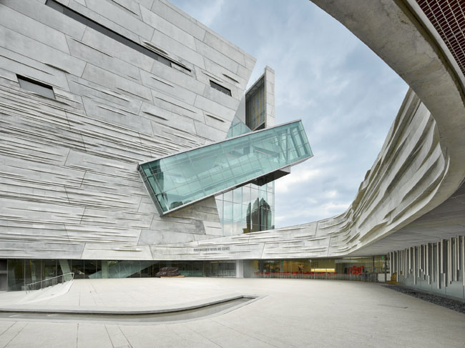
Facade
The iconic façade texture of this building is definitely one of the most popular features known by public. During the day textures on the façade cast shadow under sun lighting and from unique scenery. To make those texture properly lighted at night is no doubt a challenge for exterior lighting practice.
Dimensions
Approximate Area = 19856 ft^2
Length = 146 ft
Height = 136 ft
Introduction
Classroom
Theater
Façade
Summary
Design Criteria
Design Approach
Design Result
Lighting | Electrical | Daylighting | Acoustical | Architectural P21

Slide 31
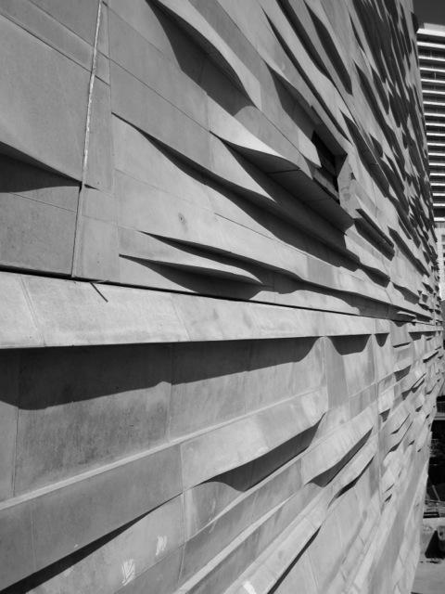
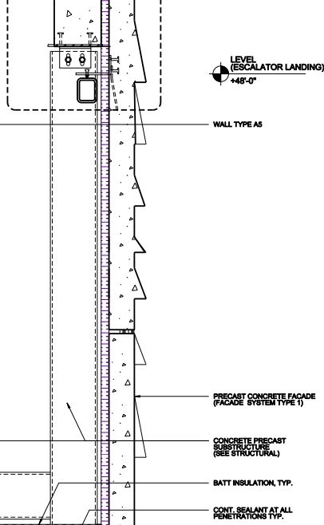
Design Criteria
Lighting design should highlight the facade texture for visual interest.
Non-uniform distribution is preferred to create a relaxing atmosphere according to John Flynn’s model.
To maintain the nighttime identity of the museum, lighting solution should also guarantee a majority of the facade is illuminated.
Target Power Density: 0.75 W/SF
Introduction
Classroom
Theater
Façade
Summary
Design Criteria
Design Approach
Design Result
Lighting | Electrical | Daylighting | Acoustical | Architectural P22

Slide 32
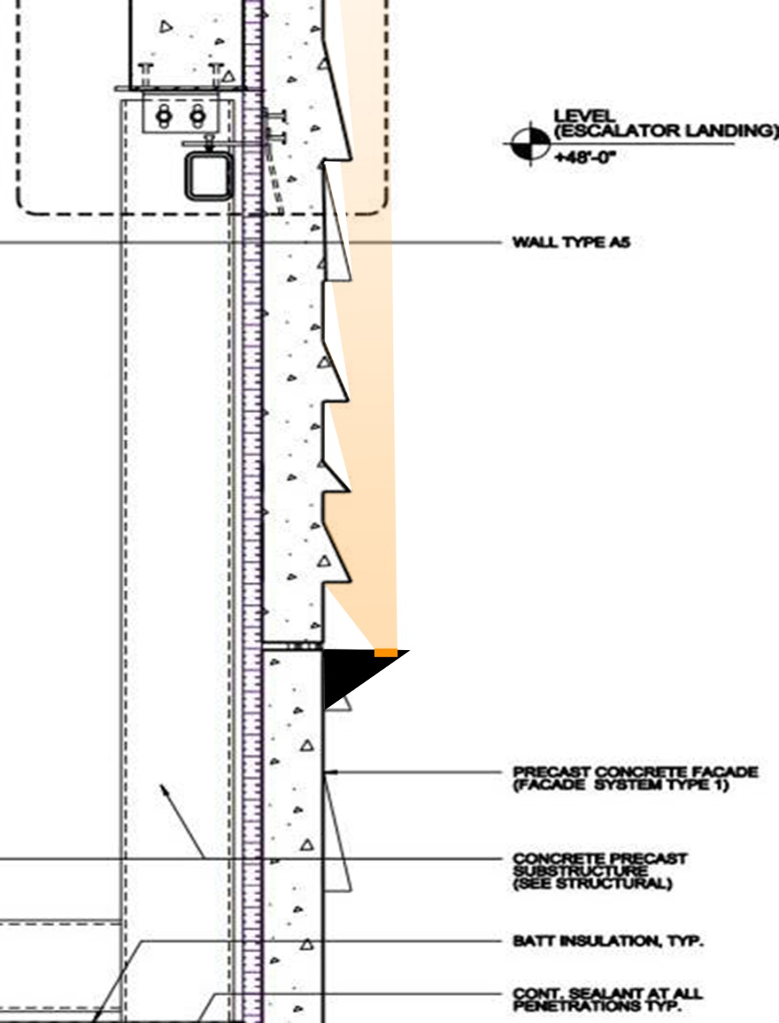
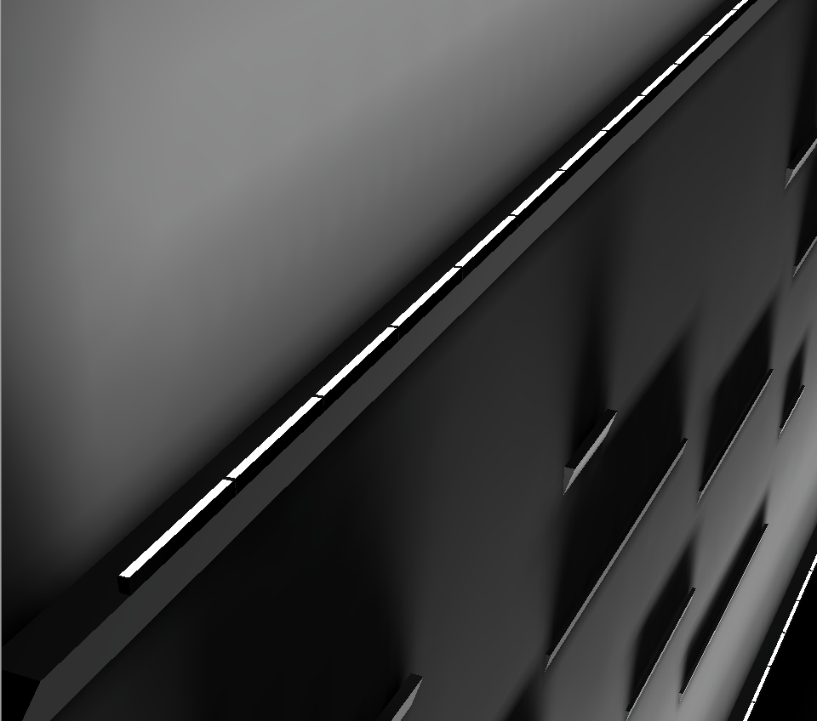
Design Approach
The façade is made of precast concrete panels 6 inch thick. Texture on the panel varies from 2 to 4 inch wide. Textures can be easily observed under daylight because the shadow they can formed a contrast with the bright façade itself. Beam with large incident angle can easily eliminate the shadow and make texture hard to be detected. Design for this space should somehow simulate the daytime situation in a different way.
To maintain the nighttime identity of the museum, lighting solution should also provide sufficient amount of light level on the façade surface.
Introduction
Classroom
Theater
Façade
Summary
Design Criteria
Design Approach
Design Result
Lighting | Electrical | Daylighting | Acoustical | Architectural P23

Slide 33
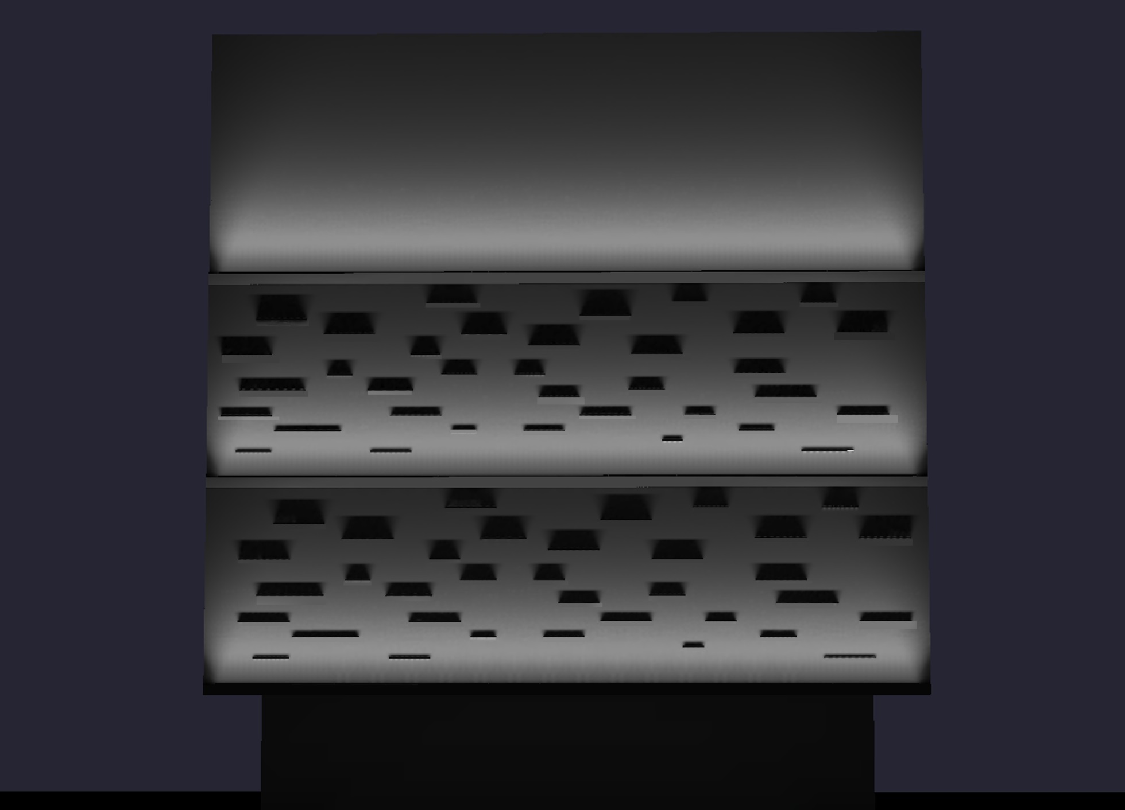
Design Result
The design solution did achieve the target of highlight façade texture at nighttime. However there are also many issues exist with this solution.
First, with most luminaire aiming towards the sky, about 20% of the lighting output is released into the night sky, causing energy waste and might even face code issue for certain district.
Also, narrow distribution require in this design is only available in a high wattage, making the solution provide twice as much light as needed.
Actual Power Density: 1.28 W/SF
Introduction
Classroom
Theater
Façade
Summary
Design Criteria
Design Approach
Design Result
Lighting | Electrical | Daylighting | Acoustical | Architectural P24

Slide 34
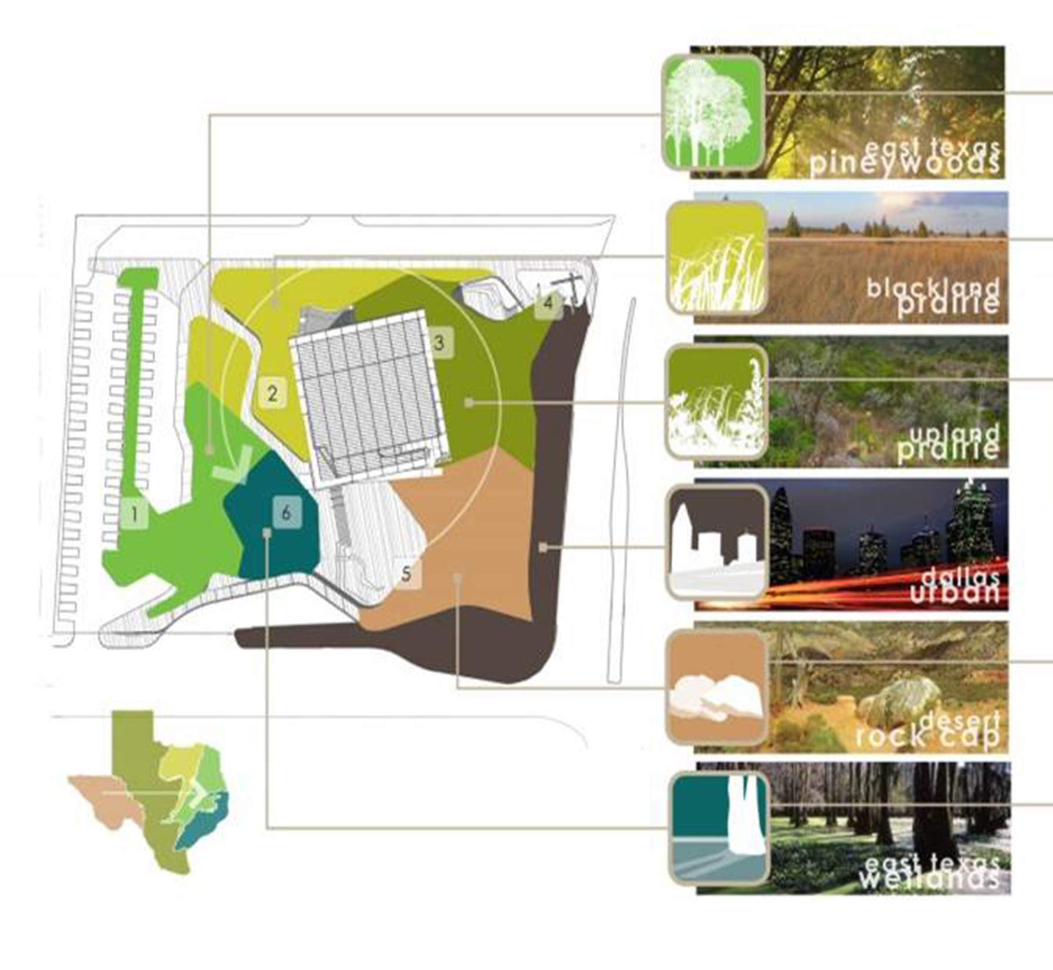
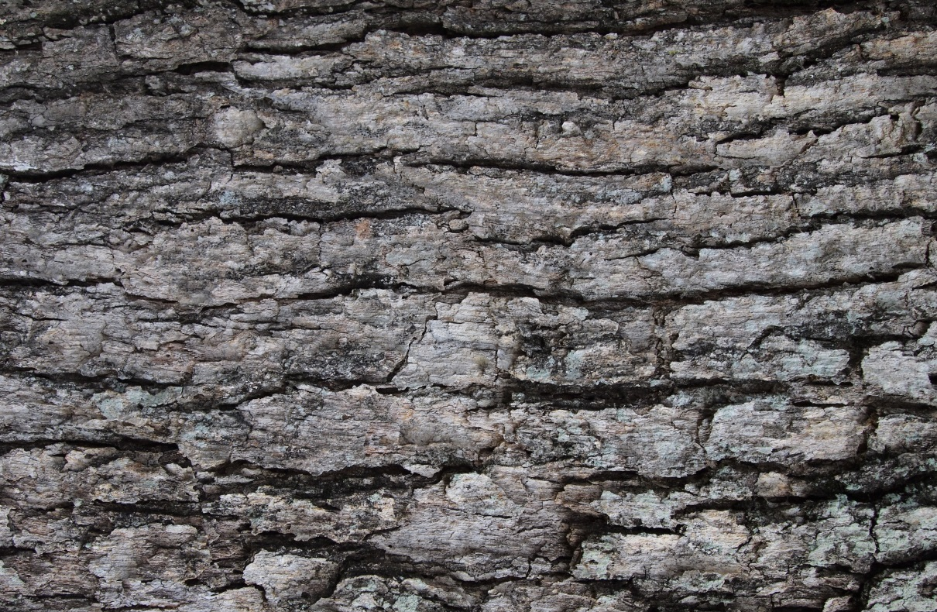
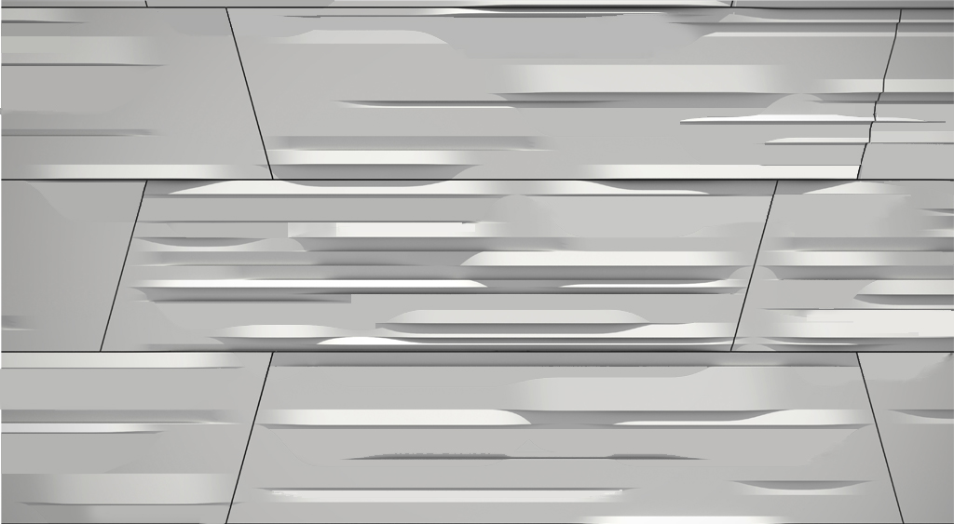
Introduction
Classroom
Theater
Façade
Summary
Design Criteria
Design Approach
Design Result
Lighting | Electrical | Daylighting | Acoustical | Architectural P25

Slide 35
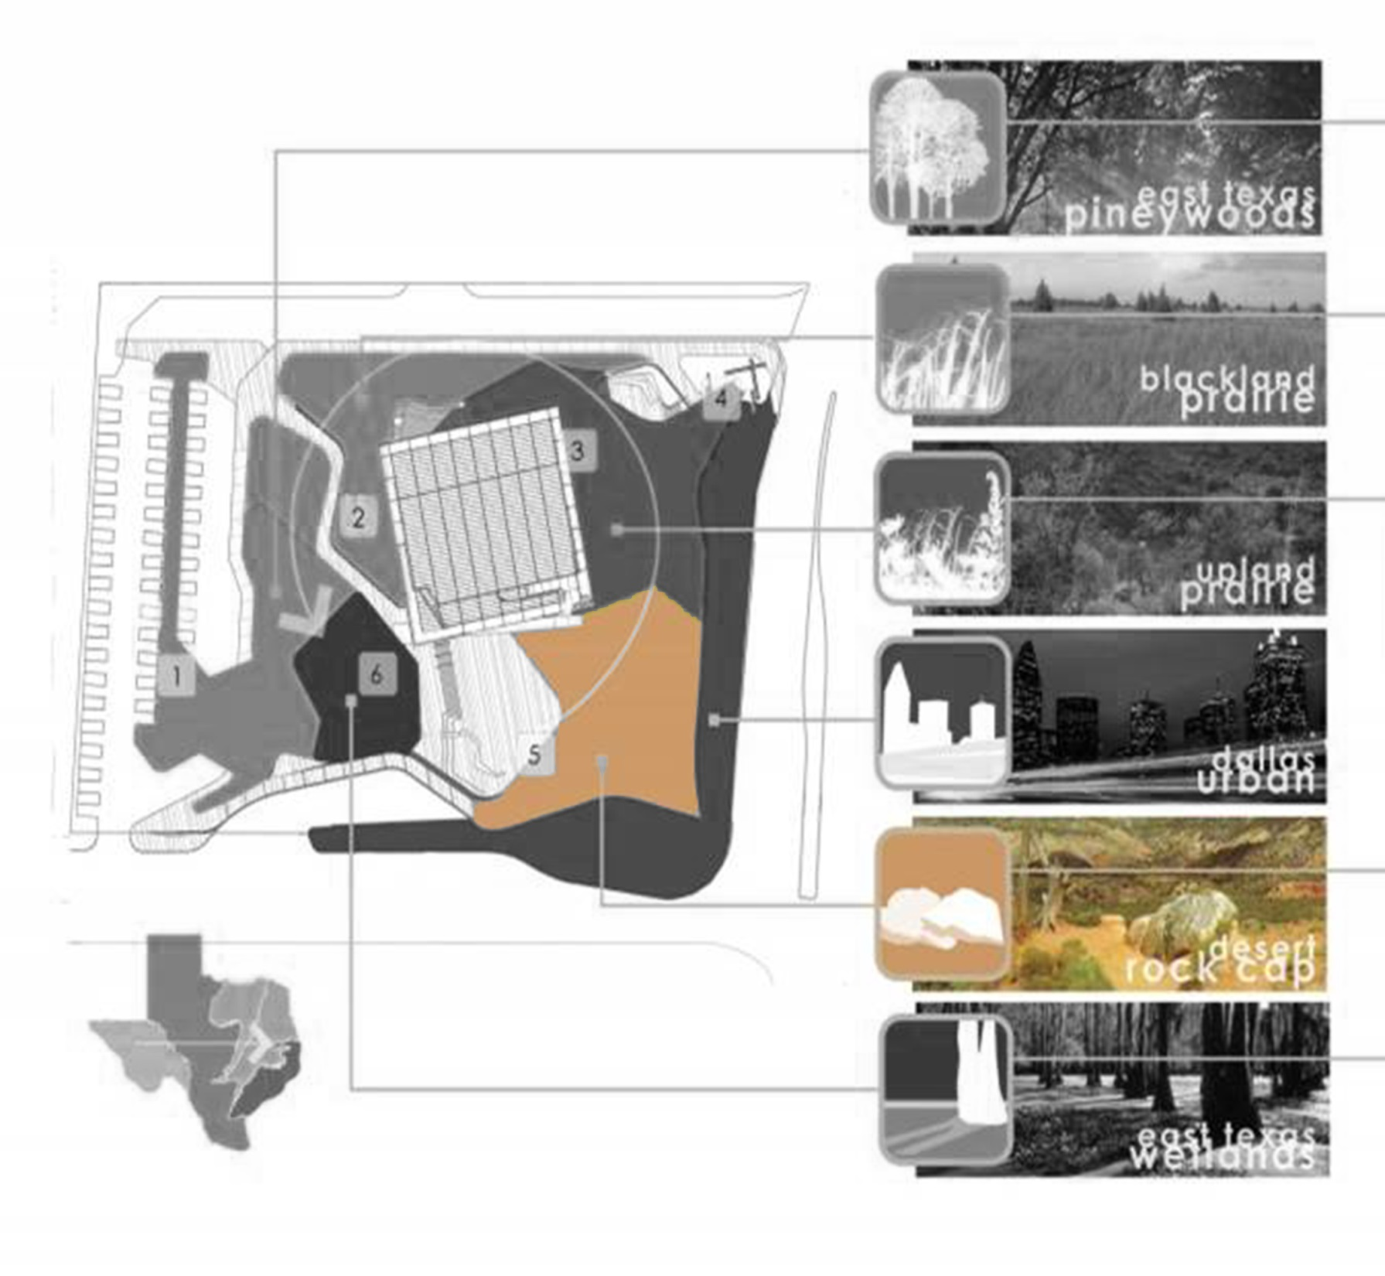
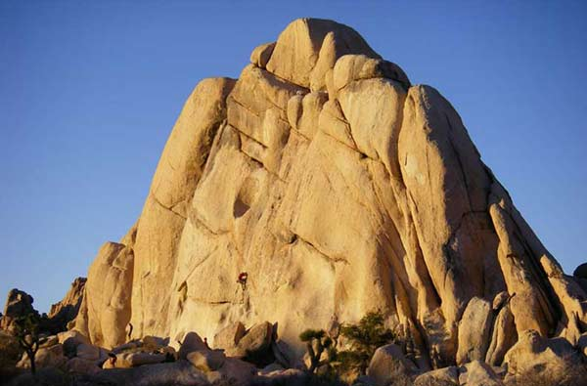
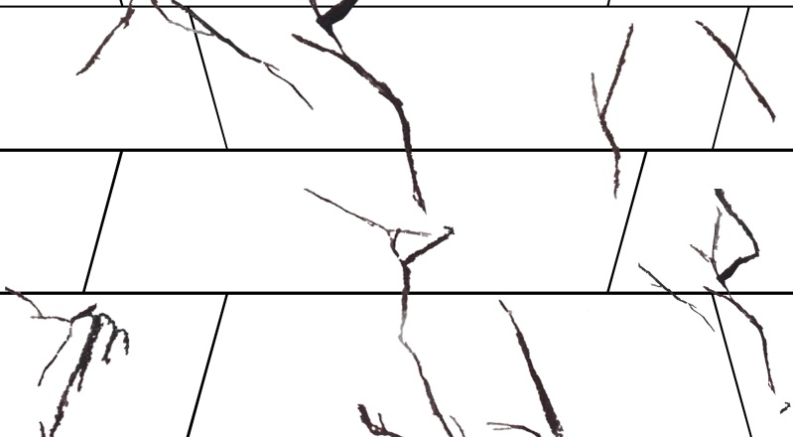
Introduction
Classroom
Theater
Façade
Summary
Design Criteria
Design Approach
Design Result
Lighting | Electrical | Daylighting | Acoustical | Architectural P26

Slide 36
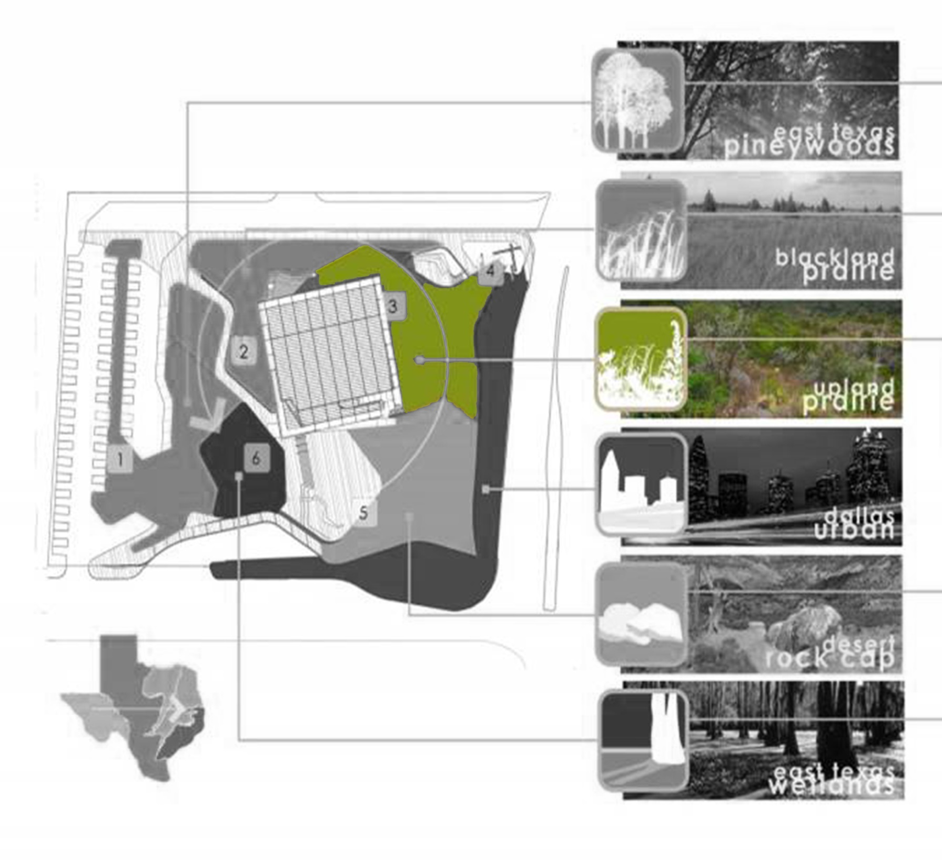
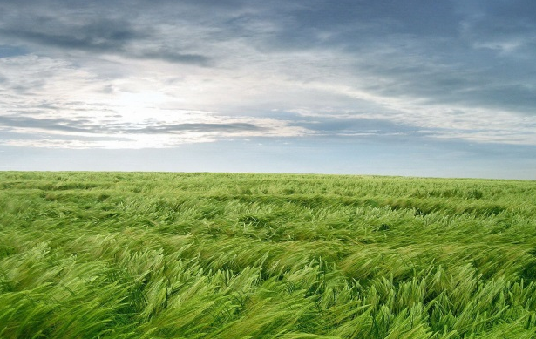
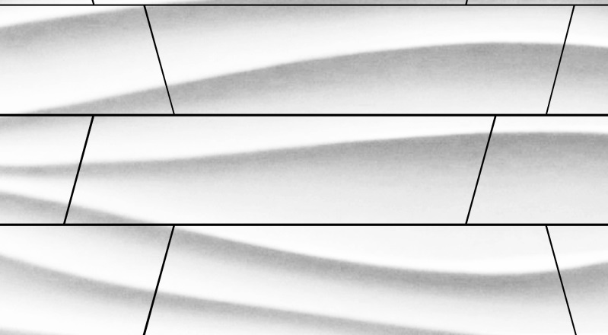
Introduction
Classroom
Lobby
Façade
Theater
Escalator
Summary
Design Criteria
Design Approach
Design Result
Lighting | Electrical | Daylighting | Acoustical | Architectural P27

Slide 37
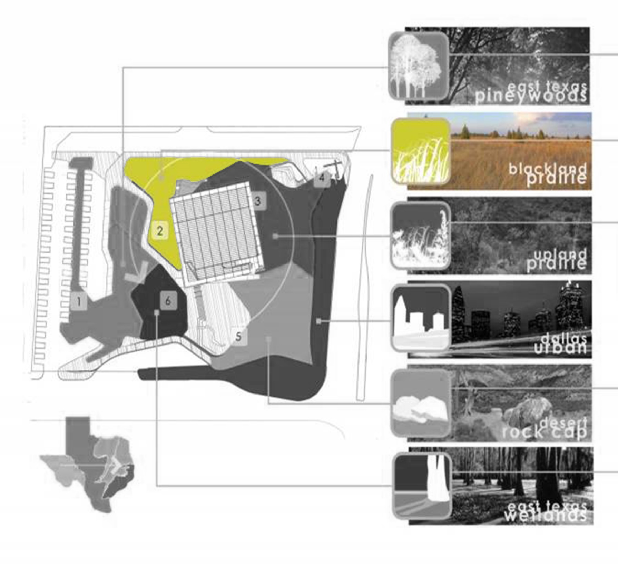
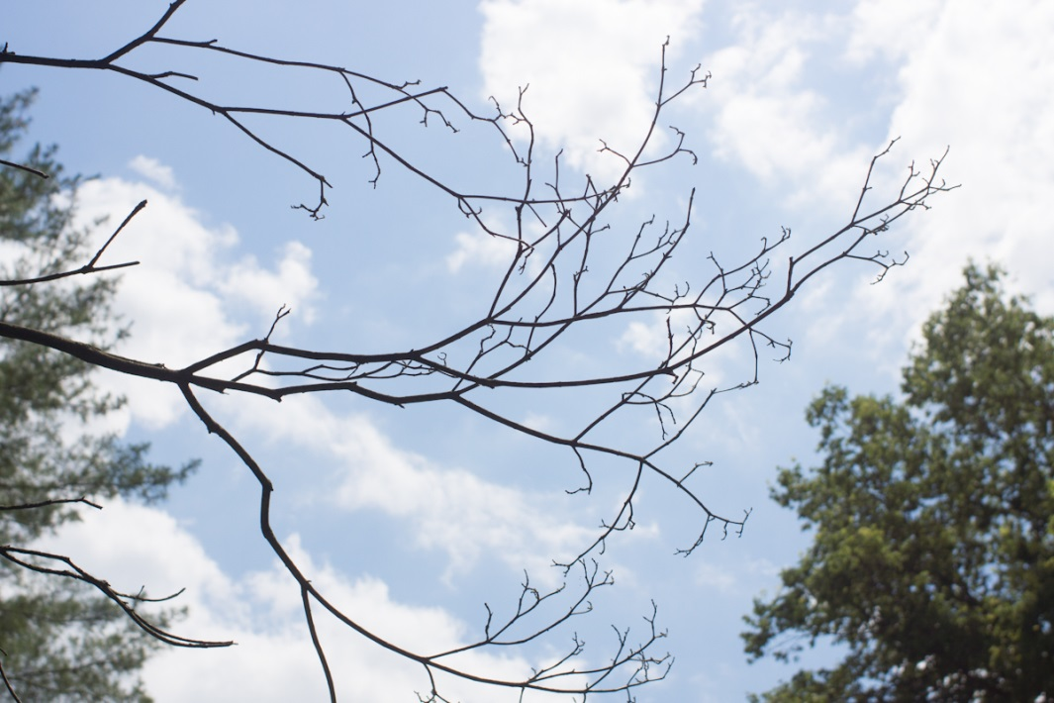

Introduction
Classroom
Theater
Façade
Summary
Design Criteria
Design Approach
Design Result
Lighting | Electrical | Daylighting | Acoustical | Architectural P28

Slide 38



Introduction
Classroom
Theater
Façade
Summary
Design Criteria
Design Approach
Design Result
Lighting | Electrical | Daylighting | Acoustical | Architectural P29

Slide 39

Summary
Lighting design for classroom is intended to highlight the unique light well system, creating a natural cave theme.
Introduction
Classroom
Lobby
Façade
Theater
Escalator
Summary
Lighting | Electrical | Daylighting | Acoustical | Architectural P30

Slide 40


Summary
Lighting design for classroom is intended to highlight the unique light well system, creating a natural cave theme.
Theater space employed a lighting scheme that simulating integrated circuit, telling the story of how modern science discovery have changed the world.
Introduction
Classroom
Lobby
Façade
Theater
Escalator
Summary
Lighting | Electrical | Daylighting | Acoustical | Architectural P30

Slide 41


Summary
Lighting design for classroom is intended to highlight the unique light well system, creating a natural cave theme.
Theater space employed a lighting scheme that simulating integrated circuit, telling the story of how modern science discovery have changed the world.
Façade lighting is designed to achieve an iconic visual effect, promoting the nighttime identity of the building in a urban environment.
Introduction
Classroom
Lobby
Façade
Theater
Escalator
Summary
Lighting | Electrical | Daylighting | Acoustical | Architectural P30

Slide 42

Summary
Lighting design for classroom is intended to highlight the unique light well system, creating a natural cave theme.
Theater space employed a lighting scheme that simulating integrated circuit, telling the story of how modern science discovery have changed the world.
Façade lighting is designed to achieve an iconic visual effect, promoting the nighttime identity of the building in a urban environment.
Introduction
Classroom
Lobby
Façade
Theater
Escalator
Summary
Lighting | Electrical | Daylighting | Acoustical | Architectural P30

Slide 43
Acknowledgements
Kevin Parfitt
Shawn Good
Kevin Houser
Richard Mistrick
Leslie Beahm
Thom Mayne
Arne Emerson
Enrique Peiniger
Jean Sundin
Jennifer Scripps
Director of Senior Thesis Program
Thesis Faculty Adviser
Faculty of Architectural Engineering
Faculty of Architectural Engineering
Faculty of Architectural Engineering
Design Director, Morphosis Architects
Design Director, Morphosis Architects
Principal, Office for Visual Interaction inc
Principal, Office for Visual Interaction inc
Business and Partnership Director,
Perot Museum of Nature and Science

Slide 44
Reference
Image Source
ASHRAE Standard 90.1-2010. Atlanta, GA: American Society of Heating, Refrigerating and Air
Condition Engineers, Inc. 2010
Houser, Mistrick, and Stefy. The IESNA Lighting Handbook 10th ed. New York, NY: Illuminating Engineering Society of North America, 2011
National Electric Code 2011, Quincy, MA: National Fire Protection Association, Inc. 2011
Metha, Johnson and Rocafort. Architectural Acoustics: Principles and Design. Prentice Hall PTR, 1999
http://www.morphosis.com/
https://texasarchitects.org/v/article-detail/Coy-Talley-on-the-Landscape-Architecture-of-the-Perot-Museum/b3/
http://photographyblog.dallasnews.com/2013/06/today-in-dallas-photo-history-1936-texas-centennial-exposition-opens.html/
http://commons.wikimedia.org/wiki/File:Museum_of_Nature_%26_Science_(Fair_Park).JPG
http://www.architecturaldigest.com/architecture/2013-02/best-architectural-projects-slideshow_slideshow_item7_8
http://morphopedia.com/projects/perot-museum-of-nature-and-science-1
http://gallery.mobile9.com/topic/?tp=circuit&ty=wp&ii=3413
http://blog.alpineinstitute.com/2014/02/route-profile-joshua-trees-dappled-mare.html
http://fredturpin.wordpress.com/2012/02/29/wind-blowing-across-fields-of-the-heart/
http://www.nipic.com/show/4/79/5397132k512204e2.html
http://www.amazon.com/Vinyl-Wall-Mural-Decal-Branches/dp/B008CL4U3W
http://www.houzz.com/photos/5334641/3d-nature-marble-panel--3d-nature-marble-wave-panel--3d-stone-tile-modern-tile-other-meo
http://www.dreamstime.com/illustration/milk-drop.html
http://www.anypics.ru/tags/%F0%E0%E7%E2%EE%E4%FB/
http://matthewdurrphotography.com/2012/06/11/lens-review-nikon-35mm-f2-5-series-e/

Slide 45
and YOU
Thanks for your support!

Slide 46




Slide 47



Slide 48



Slide 49




Slide 50




